Slide 1
CLCWA DETENTION FACILITIES AND ASSOCIATED OPEN SPACE & PARK PLAN
FEBRUARY 2013

Slide 2
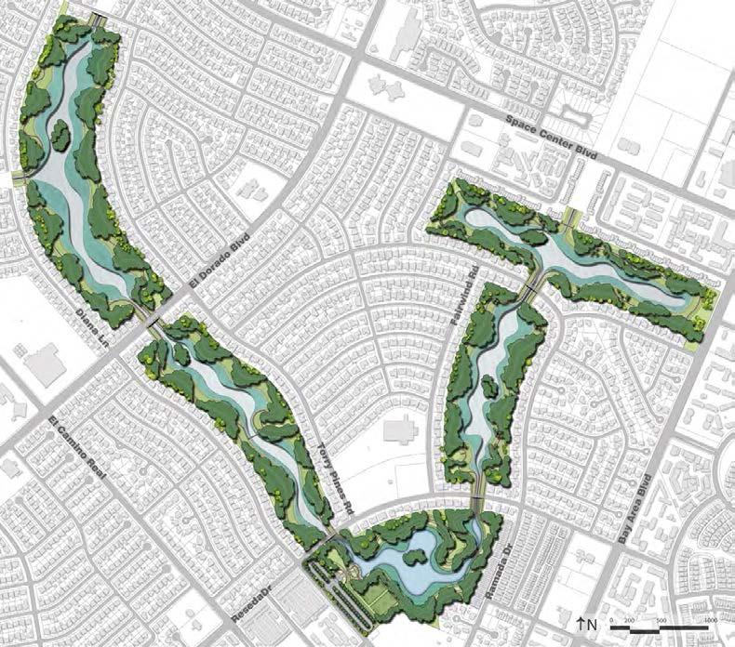
conceptual masterplan
The Master Plan is founded on the following components:
General Features
•
•
•
•
178 acres
Upland / islands area – 101 acres Permanent water area – 38 acres Wetlands area – 39 acres
Flood Mitigation Features
•
•
•
1,680-acre feet of storm water storage Water Storage Depth - 13’
Permanent Water Depth - 6’ Maximum
Water Quality Features
•
•
•
•
Emergent wetland fringe Trash Interceptor baskets Tree canopy
Return water flow polishing
Amenity Features
•
Land forming with variable slopes to create a natural character
•
•
•
•
•
Wet bottom basin Reforestation
Islands (habitat areas) Trails
Nature-friendly habitat areas
Recreation Features*
•
•
•
•
•
Athletic Sports Fields Entrance plaza / water feature Parking
Picnic and open game areas Hike and bike trails
* This is a partial list and may include other features to be determined and funded by the Community separate and apart from the flood mitigation and water quality improvements.
INTRODUCTION
5
golf course detention facilities and associated open space & park plan

Slide 3
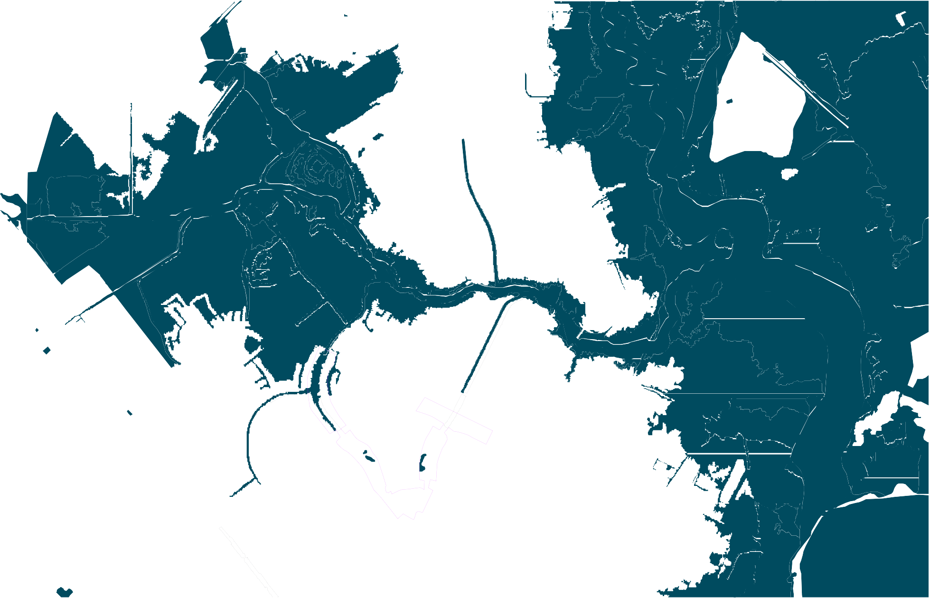
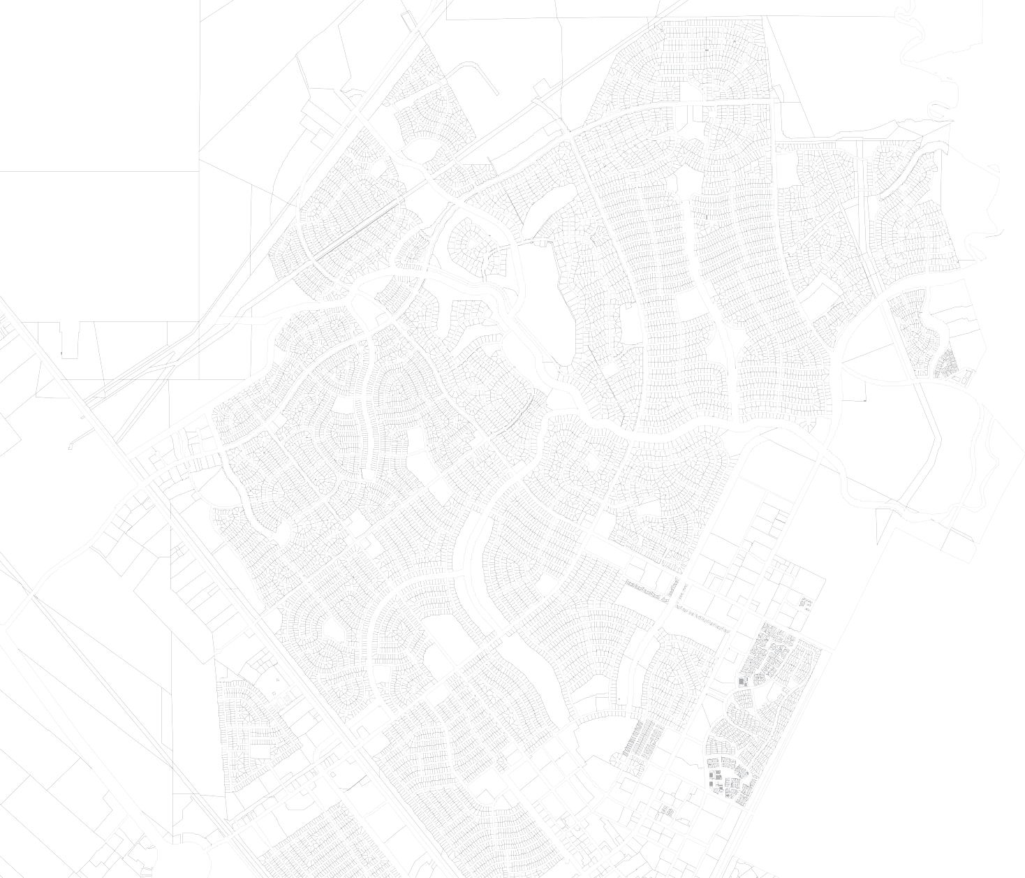


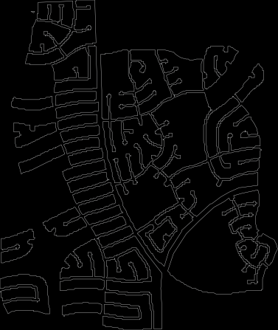
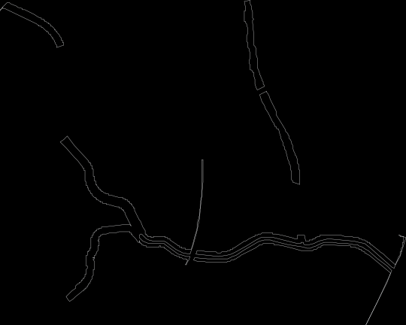

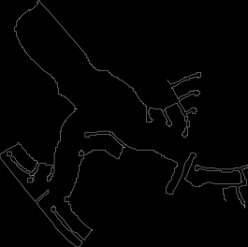

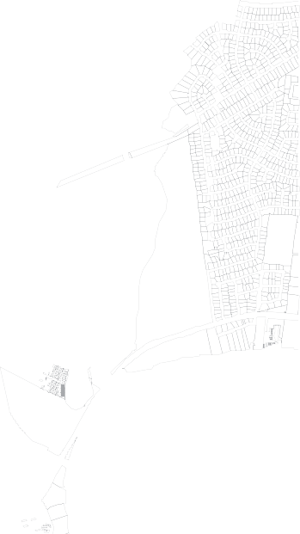
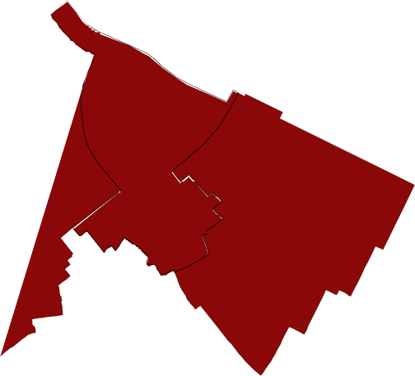
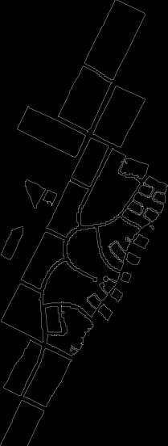
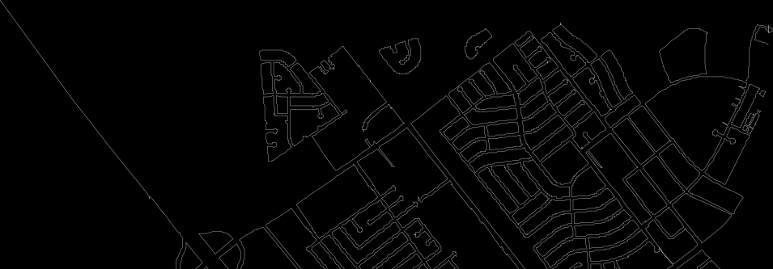
floodplains
100 YEAR FLOOD PLAIN
500 YEAR FLOOD PLAIN
CLCWA DETENTION FACILITY DRAINAGE AREA
ARMAND
BAYOU
Flooding is a result of storm water run-off. Flooding increases as development covers the ground with impervious surfaces and the ground can no longer soak up the rain. Over the last 30 years, flooding has grown to be the number one issue for the Clear Lake City area. TSARP (Tropical Storm Allison Recovery Project) study found that the “100 year” peak flow rate in Horsepen Bayou watershed increased by 20% during the 1980’s. Detention is now becoming recognized as the best method to control flooding along the Upper Texas Gulf Coast. Previously, the favored practice had been to make drainage waterways wider, deeper and straighter. The increasing urban development of the Upper Texas Gulf Coast has made this approach increasingly unaffordable by local jurisdictions and unsupportable by local communities.
HORSEPEN
BAYOU
CLCWA objectives include: 1) Preventing increased rainwater runoff due to new development; and, 2) reducing current flooding where possible through effective and proven methods such as detention.
Note:
•
The use of 100-year and 500-year event terms are
somewhat misleading.
Space Center Blvd
El Camino Real
•
A 100-year event equates to 13.5 inches of rain within a 24 hour period.
HWY 3
El Dorado Blvd
Bay Area Blvd
•
There have been 7 of these events since 1976 in CLC. In April 2009, over 9 inches in 2 hours was recorded.
I-45
•
A 500-year event equates to 19 inches of rain within a 24 hour period.
•
There have been 3 of those events since 1979.
•
Markings on the TSARP map only show those areas contiguous to a waterway and does not include depressions (ponding) which are non-contiguous. These ponding areas can be severe and can result in structural flooding and flood during heavy rains such as the 13.5” rains.
SITE ANALYSIS
11
golf course detention facilities and associated open space & park plan

Slide 4
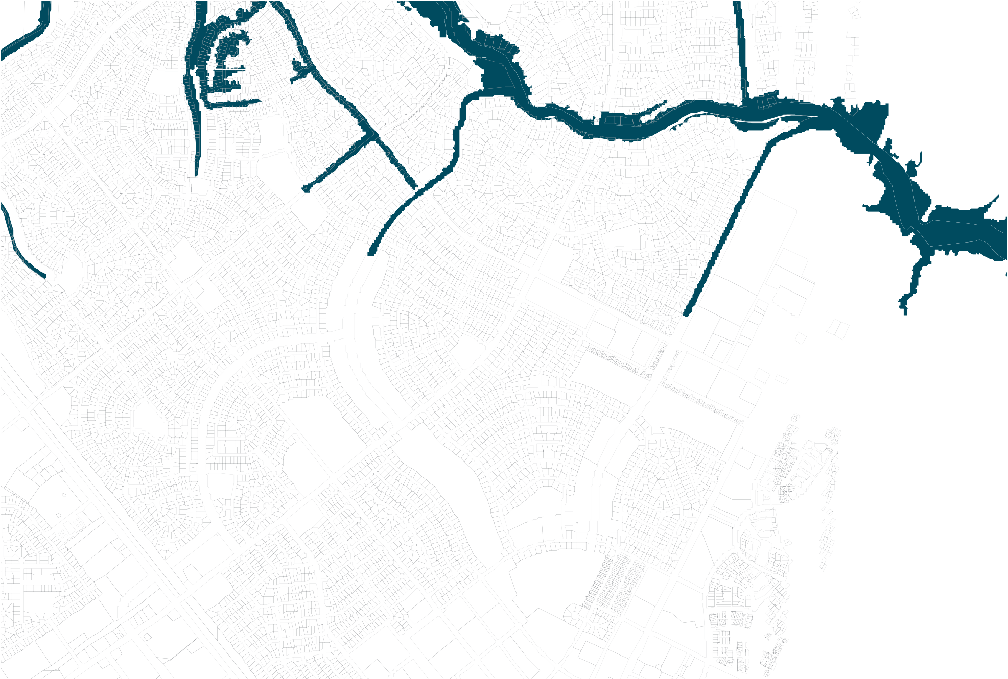
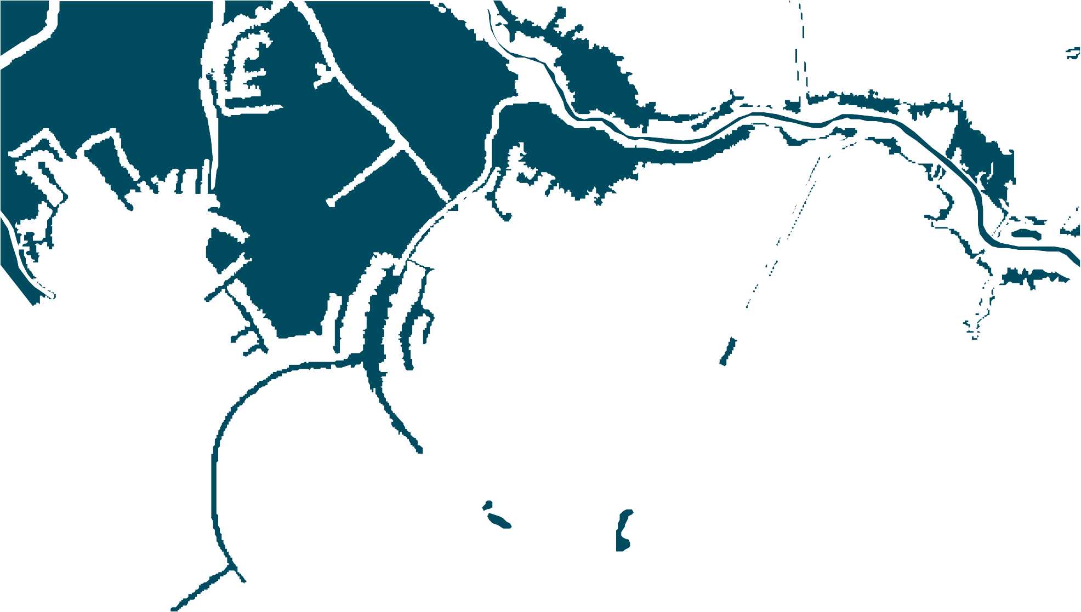

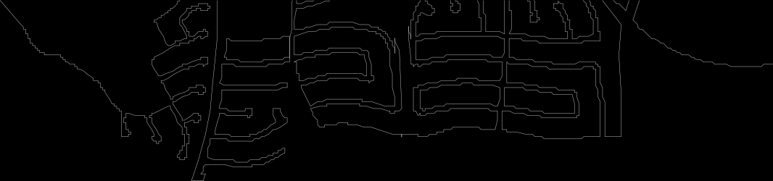
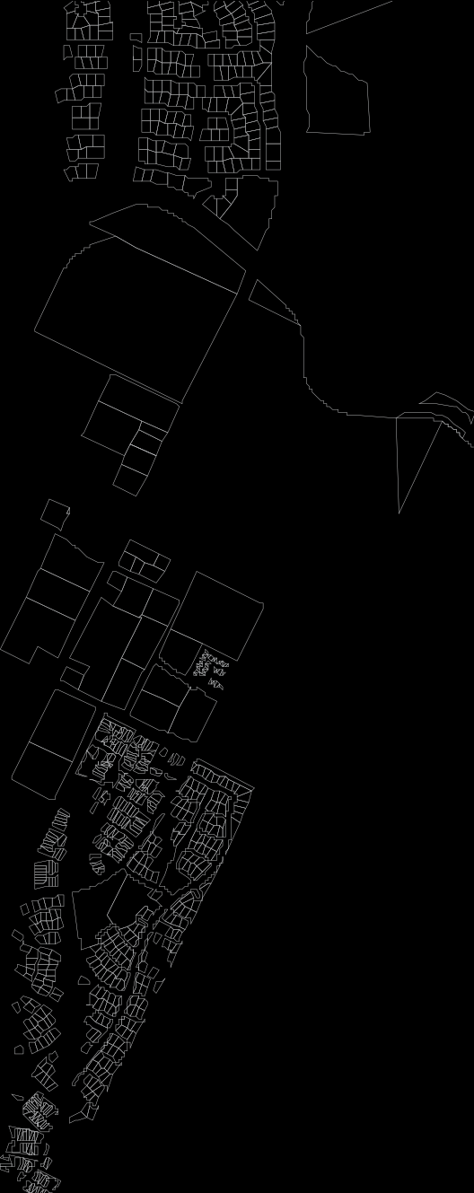
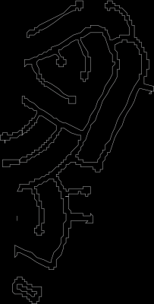
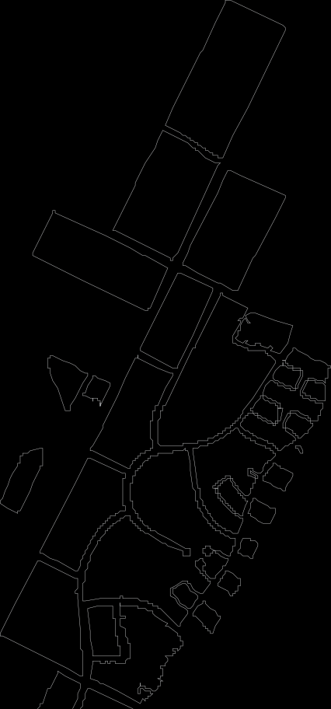
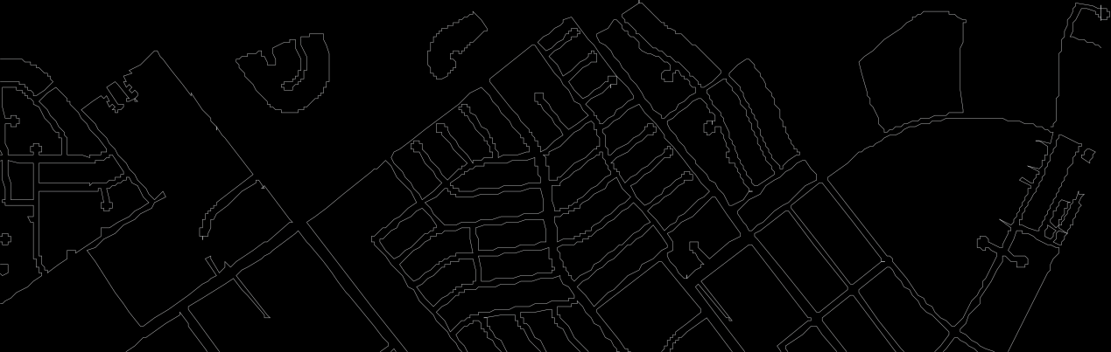
site area floodplain
100 YEAR FLOOD PLAIN
500 YEAR FLOOD PLAIN
AREAS WITH RECORD OF FLOODING
B104
HORSEPEN BAYOU
EXISTING HARRIS COUNTY FLOOD CONTROL DISTRICT CHANNEL
B104-03-00
B104-02-00
12 SITE ANALYSIS
 | golf course detention facilities and associated open space & park plan
B104-03-02
Space Center Blvd
El Camino Real
El Dorado Blvd
HWY 3
B104-03-02.1
Bay Area Blvd

Slide 5

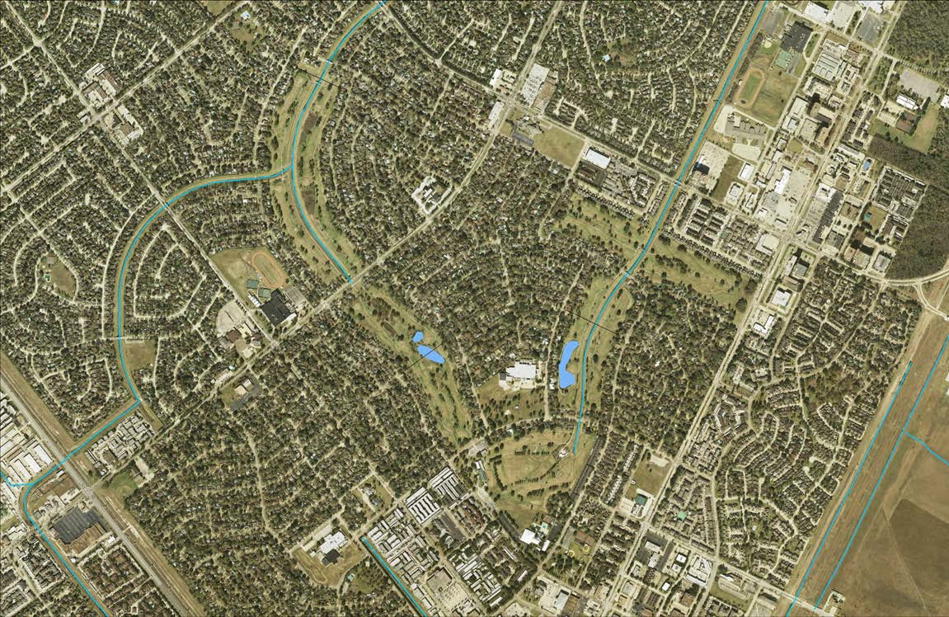
site access points and proposed bicycle facilities / shared-use paths
SHARED-USE PATH
CLEAR LAKE HIGH SCHOOL
OFF-STREET PATH
BIKE LANE
DESIGNATED BIKE ROUTE DESIGNATED SHARED ROADWAY
FALCON PASS ELEMENTARY
SOLID LINE FOR EXISTING FACILITY
DASHED LINE FOR RECOMMENDED FACILITY SOURCE:
CLEAR LAKE PEDESTRIAN AND BICYCLIST
STUDY, 2011
PRIVATE EDGE / PRIVATE ACCESS PUBLIC EDGE / PUBLIC ACCESS
OFF-STREET PATH
AT
H
T
P
E
E
R
T
S
-
F
OF
SPACE CENTER BLVD
BAY AREA BLVD
EL CAMINO REAL
DIANA LN
CLEAR LAKE
16 SITE ANALYSIS
 | golf course detention facilities and associated open space & park plan
INTERMEDIATE SCHOOL
GEMINI ST
BROADLAWN DR
Bike path locations shown are found in the Clear Lake Pedestrian and Bicyclist Study from 2011. Refer to the masterplan section of this document for bike facility locations within the site under study.
SEA LARK RD
CLEAR LAKE CITY ELEMENTARY
EL DORADO BLVD
OFF-STREET PATH
RESEDA DR
RAMADA DR
HWY 3
WHITCOMB ELEMENTARY
CLEAR LAKE RECREATION CENTER
EASTCAPE DR
COMMUNITY PARK
SATURN LN

Slide 6
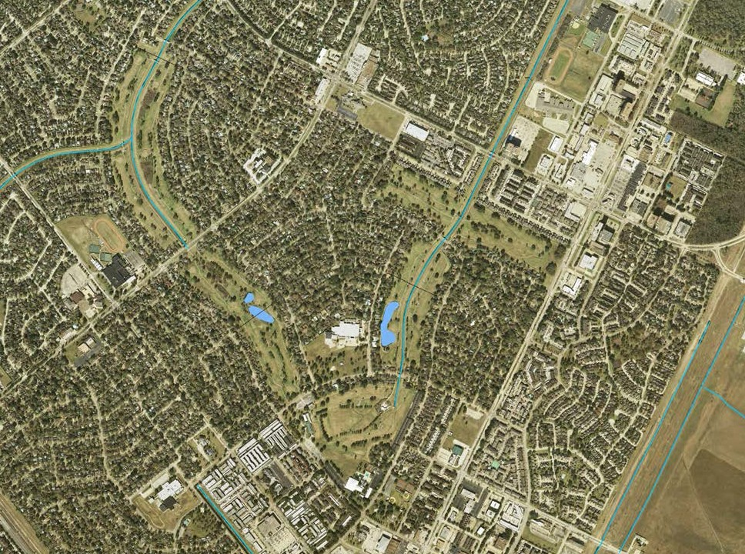




site vegetation / trees to preserve
EXISTING TREES TO PROTECT
CLEAR LAKE HIGH SCHOOL
Based on visual surveys performed by the planning team, the existing vegetation includes several tree species dominated by oak, pine and tallow trees with understory planting of some variety. There are in excess of 700 trees on the 178 acres. A combination of the severe drought experienced in Houston in the Summer of 2011 and the inoperable irrigation system resulted in some tree loss. The proposed project improvements, once completed, may preserve up to 42% of the existing mature and native trees especially along the outer edges.
FALCON PASS ELEMENTARY
SPACE CENTER BLVD
BAY AREA BLVD
EL CAMINO REAL
DIANA LN
18 SITE ANALYSIS
 | golf course detention facilities and associated open space & park plan
CLEAR LAKE INTERMEDIATE SCHOOL
GEMINI ST
BROADLAWN DR
SEA LARK RD
CLEAR LAKE CITY ELEMENTARY
EL DORADO BLVD
RESEDA DR
RAMADA DR
WHITCOMB ELEMENTARY
CLEAR LAKE RECREATION CENTER
COMMUNITY PARK
SATURN LN

Slide 7
COMMUNITY INPUT
The CLCWA embraced the concept early on of engaging the community in developing ideas for the master plan for the project. Although the primary purpose of the project is flood damage reduction and water quality improvements, CLCWA recognized the important function the property has served and will continue to serve as permanent open space in the community. The CLCWA challenged the community to both develop recommendations for recreational improvements for the project as well as methods and sources of funds to implement these improvements. The narrative below describes the organization and process of the Advisory Group followed by its recommendations. Implementation of the recommendations are included in the Implementation section.
No sale of property to be considered.
Complete study by September 1, 2012.
HISTORY AND METHODS
DELIVERABLES
January 24, 2012: First Town Hall meeting - solicited ideas, asked for volunteers.
1. Evaluate which ideas fit best into the overall plan of detention ponds, highest benefit to the entire area, and desire to keep the area as green as possible.
February: Frank Weary and John Jacob appointed co-chairs of the Advisory Group.
March: Remainder of the Advisory Group appointed (met twice a month through August); formal charter was provided to the Advisory Group with primary purpose to solicit community input with target date set for early September.
2. Using the section designations on the master aerial map, provide recommendations as to which proposals fit best into each section with supporting reasons.
GROUP MEMBERSHIP
May 10, 2012: Second Town Hall meeting - solicited volunteers for subcommittee areas of interest; selected chairs of subcommittee and set deadline for proposals by area for late August.
Two Co-chairs – Frank Weary and John Jacob
3. Understand that final decisions will be made by the Board of the CLCWA after a review of the recommendations, review by the CLCWA engineers and architects, confirmation of
funding, and agreement with other governmental entities participating in the master plan.
Steering Committee Members – Diverse group interested in area
July: Advisory Group meeting with subcommittee chairs to clarify objectives and provide proposal format.
Various sub-committee members representing area groups
4. Final decision by the CLCWA will be incorporated into the Master Plan and presented to the community upon approval by the Board of Directors.
GOALS OF ADVISORY GROUP
August 30, 2012: Third Town Hall meeting - subcommittee proposals presented; included two landscaping reports and Outstanding Ideas (not covered by subcommittees).
1. Organize the group to include interested stakeholders in area.
ADDITIONAL INFORMATION FROM CLCWA BOARD
Planning average depth of detention ponds will be 14 foot.
Approved Advisory Group budget of $1,100.
Side slope at least 4 to 1 ratio.
SWA Landscape Architects was hired by CLCWA to prepare the Master Plan.
September: Last Advisory Group meeting - reviewed proposals in detail and formulated
20 COMMUNITY INPUT
 | golf course detention facilities and associated open space & park plan
2. Gather input from the residential and business community on the types of multi-use facilities desired through input from Town Hall meetings, web-site surveys, etc. Facilities must be compatible and adaptable within a detention pond environment.
priorities; co-chairs met with CLCWA Board and presented recommendations.
3. Evaluate each idea and proposal considering parking requirements, impact on existing homeowners, and in keeping with serving the greatest number of area residents.
SUBCOMMITTEE PROPOSALS
Athletic Fields
4. Gather landscaping ideas which would enhance the area, consider privacy and safety of existing homeowners along the property lines, and enhance the quality of life for the area.
5. Setback of 35 feet from property line, drop of 8 foot with ledge for hike and bike trail, and then slope to bottom of detention pond.
•
•
3 multi-use practice fields along Bay Area
Baseball, sand volleyball, 2 more multi-use fields and other facilities near Rec
Center
Parking and rest room facilities needed
Sports leagues likely to aid in field creation and maintenance Alternate configurations included
5. Explore types of funding which might be available through grants, matching funds, donations, and other sources.
6. Filtering (wetlands) at two ends of former fairways feeding into the drainage ditches.
•
•
•
7. Wet ponds (maintain 2 to 3 foot of water) would need to be near either of the two existing CLCWA water wells (current water hazard areas).
6. Promote and build community support and involvement.
Community Gardens
Evaluate all proposals under the following criteria:
  No bright lighting in any area other than the former clubhouse area.
  Recreational amenities must be funded from sources outside the CLCWA.
  Low impact amenities have priority in keeping with desire to maintain the area as green as possible.
  Amenities requiring parking areas should be restricted to former clubhouse area.
  Former fairway areas should consider daylight only amenities.
  No long term rentals or permanent structures by private organizations.
Preliminary Interest Groups might include the following: Athletic Fields, Hike and Bike Trails, Wetlands, Community Gardens, Dog Park, Landscaping-reforestation-nature friendly spaces, and “Others”. CLC Green Plan members are asked to decide which areas they might want to facilitate before the meeting. Additional facilitation duties might include assisting with identifying Interest Group meeting locations, meeting times, and aiding the group in understanding the constraints that we must observe.
•
•
•
•
2+ acres requested for multiple gardens
2 alternate locations suggested – Bay Area or near Rec Center Some parking needed; water for garden irrigation needed Funding routes through Urban Harvest and others likely

Slide 8
Dog Park
•
•
3 acres requested for two dog parks (large and small dogs) Dog park fencing and ADA access required; water for dogs required; parking required
Preferred location near Rec Center
501c.3 exists to help raise funds for construction; City/County
participation on maintenance
ADVISORY GROUP RECOMMENDATIONS
Phase 1 of the development should include:
  Hike and Bike Trails
  Green space development including:
    Tree preservation and replacement
    Flooding tolerant native plants
    Wildlife areas
    Water features
    Wetlands
    Open spaces and playground facilities
•
•
Hike and Bike Trails
•
•
•
2 trail loops similar to SWA proposal suggested
As recommended in H-GAC, trails tie to existing/proposed trails outside land Funding through Conservancy with inter-governmental, corporate and running club financing
Subsequent phases dependent on funding should include:
  Community Gardens
  Athletic Fields
  Dog Park
Landscape 1 – Trees and Grading
•
•
•
•
•
Recommend using 50 foot buffer to match proximity of old cart path Wider buffer also helps save existing trees
Several “specific interest” areas recommended for preservation
To maintain capacity, recommend going to a greater depth at bottom Several specific recommendations included regarding detailed engineering concepts
Proposals have minimal construction costs
Special Attention should be paid to:
  Parking, including adding limited parking for access to amenities
  Privacy and security (primary concern of adjacent home owners)
  Limiting noise and nighttime lighting
  Rest room facilities are required, but could be somewhat centralized
•
Landscape 2 – Plants and Wildlife Habitat
Strong consideration should be given to formation of a Conservancy as soon as reasonable
•
•
•
•
Recommends specific trees and shrubs consistent with periodic flooding Plantings also recommended for wildlife habitats, birding, butterflies, etc. Plantings broken between lower (wetter) and higher (drier) areas
Funding suggested through intergovernmental, specific corporations, and various
grants
Minimal maintenance plantings are recommended to reduce operating costs
•
Wetlands and Lakes
•
•
•
General recommendations for natural water filtration (wetlands) and lakes Reeds and shrub areas at water edges of 5-5- feet preferred
Wetland and lake areas easily incorporated in both Master Plan and detailed
engineering
Minimal construction funding needed beyond grading; Federal grants will
supplement
•
Outstanding Ideas
•
•
•
•
Many ideas and concerns submitted without assignment to subcommittees Primary areas not covered concerned playground and other “park” facilities Sponsorship and memorial postings proposed for funding assistance Principle concerns were security and funding
COMMUNITY INPUT
21
golf course detention facilities and associated open space & park plan

Slide 9

MASTERPLAN
1
SPORTS FIELDS (150’ x 250’ EACH)
2
PARKING LOT (352 cars)
3
MAIN ENTRANCE AND PLAZA WITH WATER FEATURE
4
USES AND ACTIVITIES TO BE DETERMINED
5
WETLAND AREA
6
TREES AND UNDERSTORY PLANTING
7
PEDESTRIAN BRIDGE CROSSING AND TRAILS
8
UPPER PAVED TRAIL
9
HABITAT ISLAND
10
PRESERVED TREES
NOTE: Native prairie grass and wildflower areas will be intermingled in various sections.
22 MASTERPLAN
 | golf course detention facilities and associated open space & park plan
WATER STORAGE (ACRE FT) | WATER AREA (ACRE) | WETLAND AREA (ACRE) | ISLAND AREA (ACRE) | TRAIL LENGTH (MILES)
1680 | 38 | 39 | 2.5 | 6.0

Slide 10
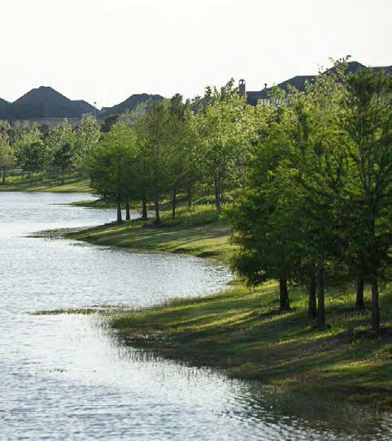
storm water capacity enhancements
The following summary and illustrations set out the details of the recommended master plan.
This includes information on how the project will be built over a series of phases. Recreational features that may also be incorporated into the project as funding allows are also illustrated in the master plan.
Flood Damage Reduction Features (FDR) Features
  178 acres
  1,680-acre feet of storm water storage
  Water storage depth - 13'
  Permanent water level - 6'
  Permanent water area – 38 acres
  Wetlands area – 39 acres
g. Upland / islands area – 101 acres
h. FDR Excavation - 3.0 million cubic yards
Potential Capital Funding Scenarios
  CLCWA (Retention/ Detention Only)
Harris County and City of Houston
Corporate Partners
Government Agency Partners (TX General Land Office, Texas Parks and Wildlife, etc.)
NGO Partners
Foundations
Water Quality and Park Features
  Water Quality
    Emergent wetland fringe
    Trash interceptors
    Riparian tree canopy
    Return flow polishing
e. Management & Operations
Structures
  Conservancy 501(c)3
  Intergovernment Partnership
  Others
Operations
1. 6m gpd = 4,166gpm = 9.2cfs
Expenses
  Scheduled items
    mowing, trash removal, vegetation pruning, trail maintenance
    invasive plants and trees management
  Un-scheduled items -
    tree removal, erosion control
Amenity Features (Including recommendations by the Advisory Committee)
  Wet bottom basin
  Created wetlands
  Land forming and shaping
Reforestation
Habitat creation
Parking and restrooms
Lower and upper bench hike & bike trails
Multi-purpose athletic fields (with expansion on HOA site)
Community Garden
Dog Park
Nature playground
Phasing Options
  Interim uses
  Five possible construction phases
MASTERPLAN
23
golf course detention facilities and associated open space & park plan

Slide 11
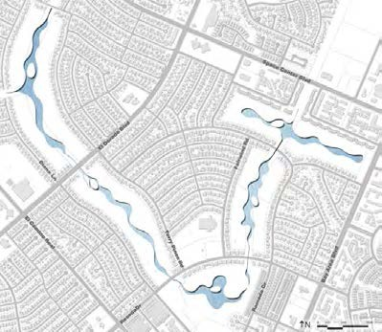
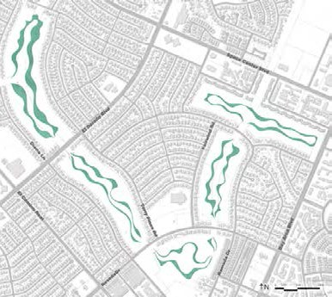
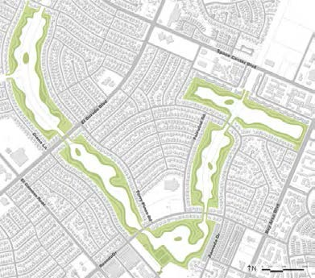
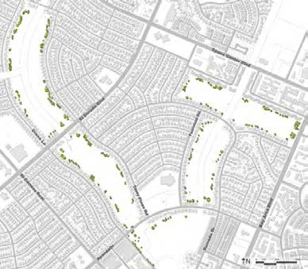
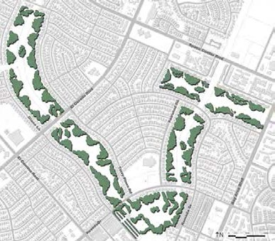
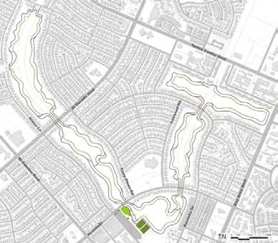
masterplan feature by system
WATER
WETLAND
24 MASTERPLAN
 | golf course detention facilities and associated open space & park plan
UPLAND AND ISLANDS
PRESERVED TREES
REFORESTED AREA
TRAILS AND AMENITIES

Slide 12
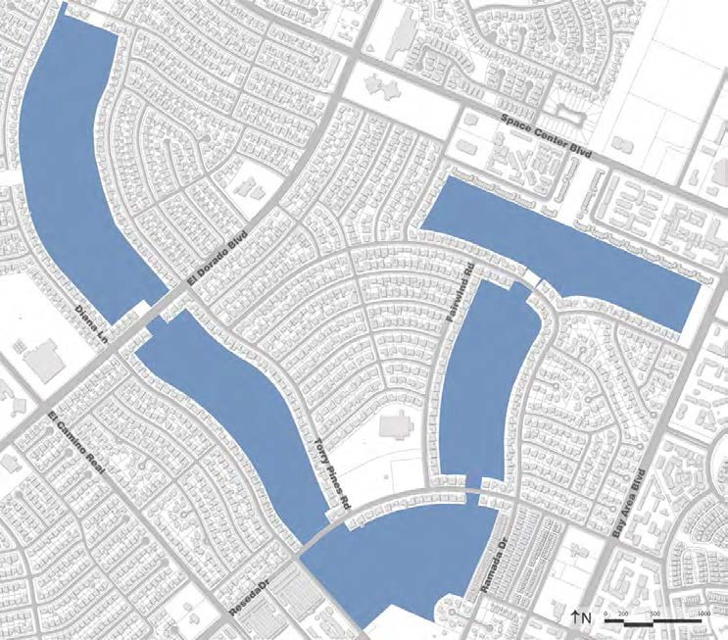
possible phasing diagram
1
1 - 5 YEARS
2
4 - 7 YEARS
3
7 - 9 YEARS
4
9 - 12 YEARS
5
12 - 15 YEARS
5
3
26 MASTERPLAN
 | golf course detention facilities and associated open space & park plan
2
4
1

Slide 13
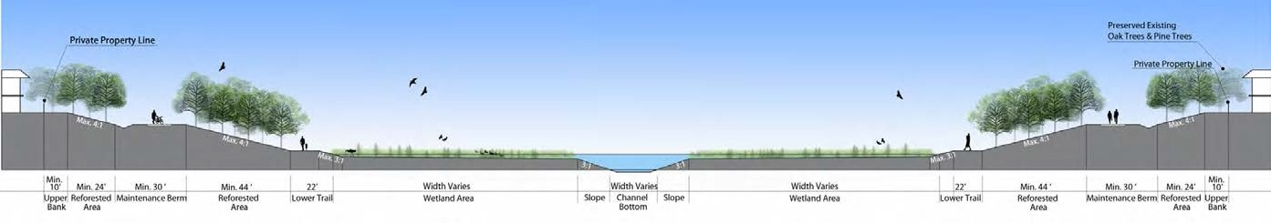
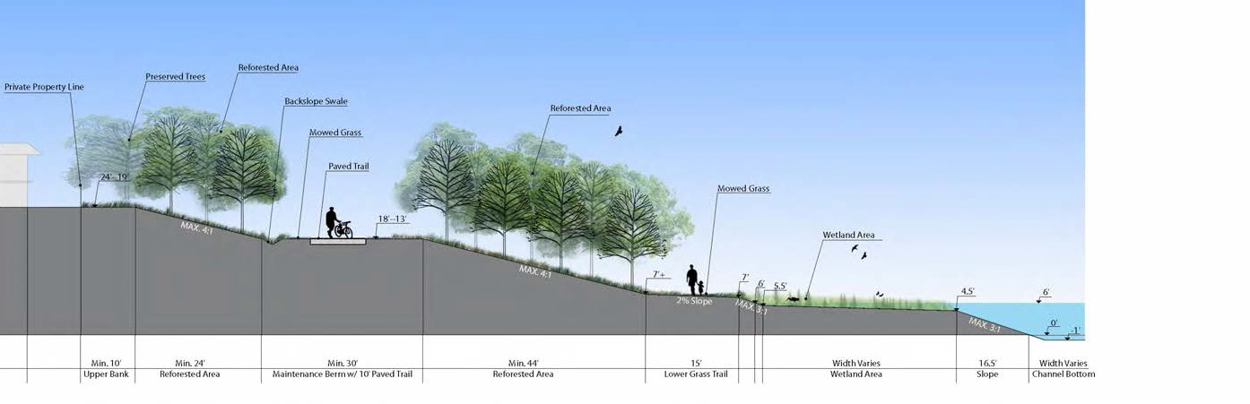
proposed typical section
proposed typical section in detail
MASTERPLAN
27
golf course detention facilities and associated open space & park plan

Slide 14
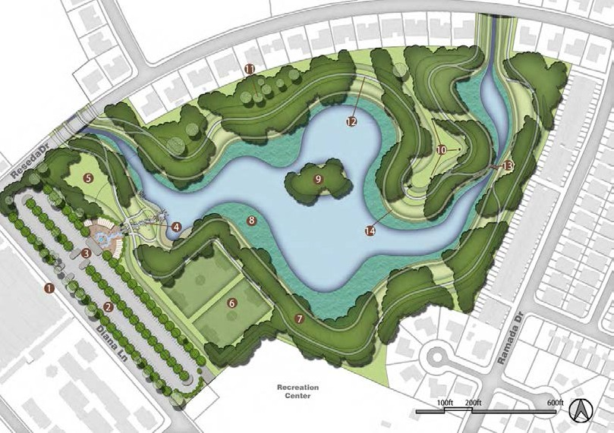
phase 1
y e a r s 1 - 5
1
MAIN ENTRANCE AND PLAZA WITH WATER FEATURE
2
PARKING LOT (352 cars)
3
PLAZA WITH WATER FEATURE
4
WATER RUNNEL WITH BOULDERS AND BRIDGES
5
TO BE DETERMINED
6
SPORTS FIELDS (150’ x 250’ EACH)
7
REFORESTED AREA
8
WETLAND AREA
9
HABITAT ISLAND
10
PRESERVED WELLS
11
PRESERVED TREES
28 MASTERPLAN
 | golf course detention facilities and associated open space & park plan
12
PAVED UPPER BANK TRAIL
13
BRIDGE CROSSING
14
GRASS LOWER PATH
NOTE: The indicated uses and activities show preliminary ideas and may expand to
include other improvements.
WATER STORAGE (ACRE FT) | WATER AREA (ACRE) | WETLAND AREA (ACRE) | ISLAND AREA (ACRE) | TRAIL LENGTH (MILES)
345 | 8 | 6 | 0.5 | 1.1

Slide 15
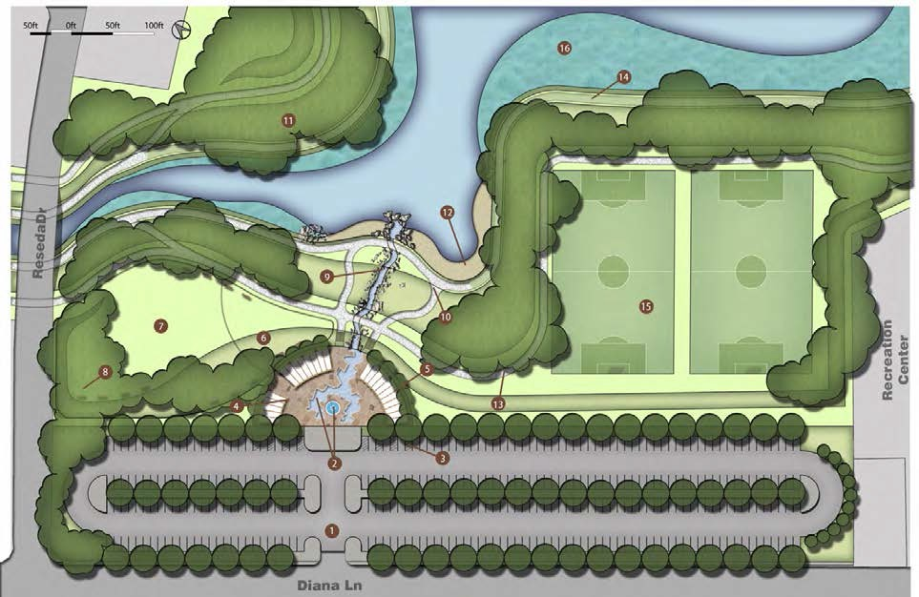
phase 1 entry plan
1
MAIN ENTRANCE
2
WATER FEATURE AND POOL
3
HANDICAP PARKING
4
FLAGSTONE PAVING PLAZA
5
TRELLIS
6
TO BE DETERMINED
7
TO BE DETERMINED
8
BENCHES
9
WATER CASCADE WITH BOULDERS AND BRIDGE
10
RAMP
11
REFORESTED AREA
12
PEBBLE BEACH
13
PAVED UPPER BANK TRAIL
14
GRASS LOWER PATH
15
SPORTS FIELDS (150’ x 250’ EACH)
16
WETLAND AREA
MASTERPLAN
29
golf course detention facilities and associated open space & park plan

Slide 16
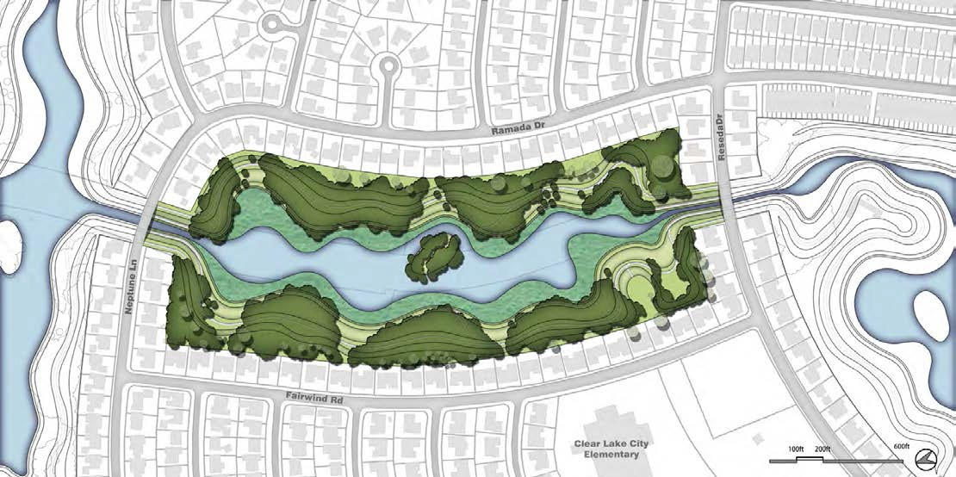
phase 2
y e a r s 4 - 7
32 MASTERPLAN
 | golf course detention facilities and associated open space & park plan
WATER STORAGE (ACRE FT) | WATER AREA (ACRE) | WETLAND AREA (ACRE) | ISLAND AREA (ACRE) | TRAIL LENGTH (MILES)
260 | 5 | 9 | 0.5 | 1.0

Slide 17
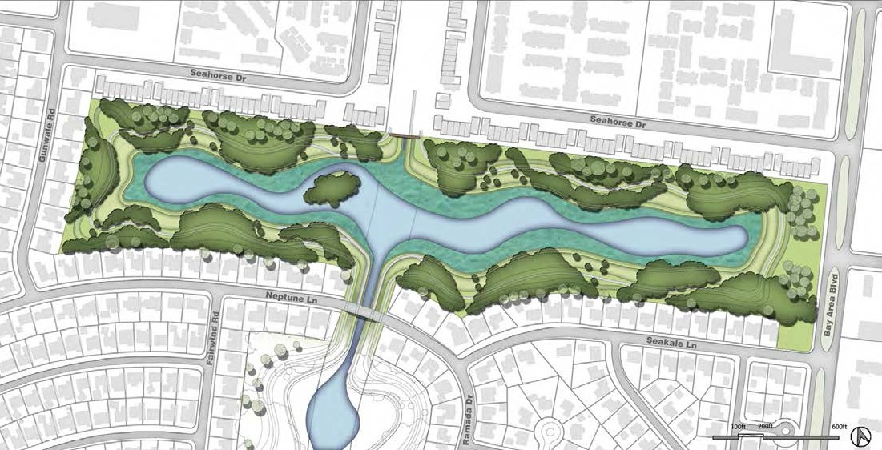
phase 3
y e a r s 7 - 9
WATER STORAGE (ACRE FT) | WATER AREA (ACRE) | WETLAND AREA (ACRE) | ISLAND AREA (ACRE) | TRAIL LENGTH (MILES)
318 | 8 | 6 | 0.5 | 1.3
MASTERPLAN
33
golf course detention facilities and associated open space & park plan

Slide 18
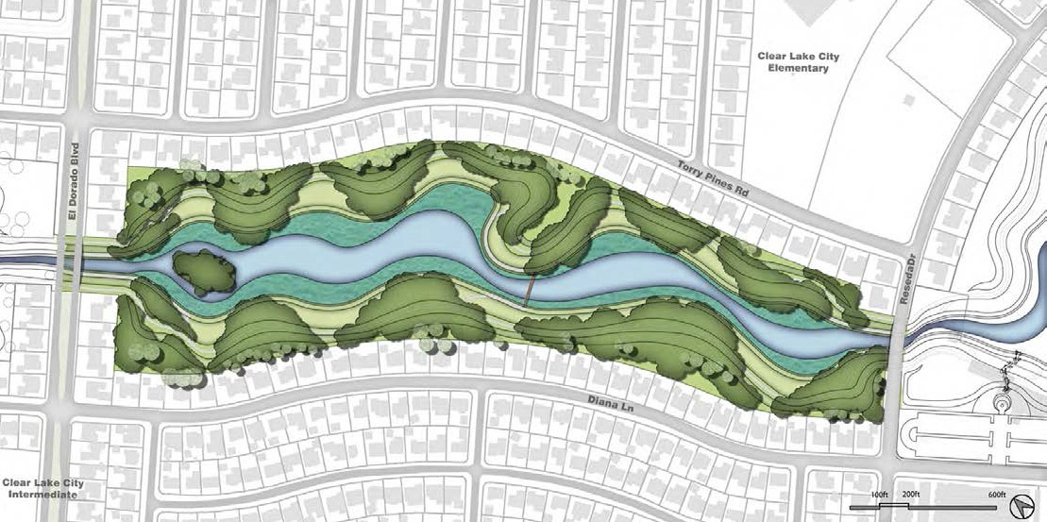
phase 4
y e a r s 9 - 1 2
34 MASTERPLAN
 | golf course detention facilities and associated open space & park plan
WATER STORAGE (ACRE FT) | WATER AREA (ACRE) | WETLAND AREA (ACRE) | ISLAND AREA (ACRE) | TRAIL LENGTH (MILES)
292 | 7 | 7 | 0.5 | 1.2

Slide 19
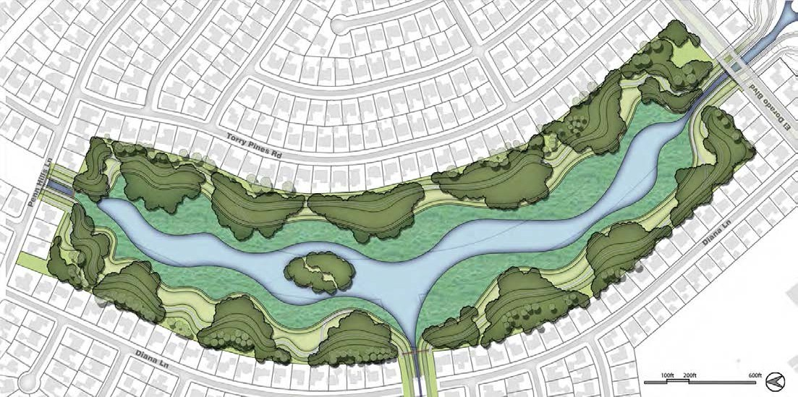
phase 5
y e a r s 1 2 - 1 5
WATER STORAGE (ACRE FT) | WATER AREA (ACRE) | WETLAND AREA (ACRE) | ISLAND AREA (ACRE) | TRAIL LENGTH (MILES)
442 | 10 | 11 | 0.5 | 1.5
MASTERPLAN
35
golf course detention facilities and associated open space & park plan

Slide 20
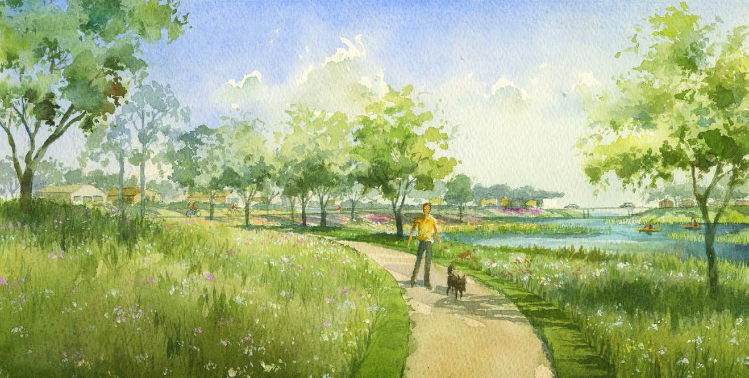
site rendering : upland view
36 MASTERPLAN
 | golf course detention facilities and associated open space & park plan
Six miles of trails with convenient trail loops connect the 178-acre property to adjoining neighborhoods and the regional Clear Lake pedestrian and bike system.

Slide 21
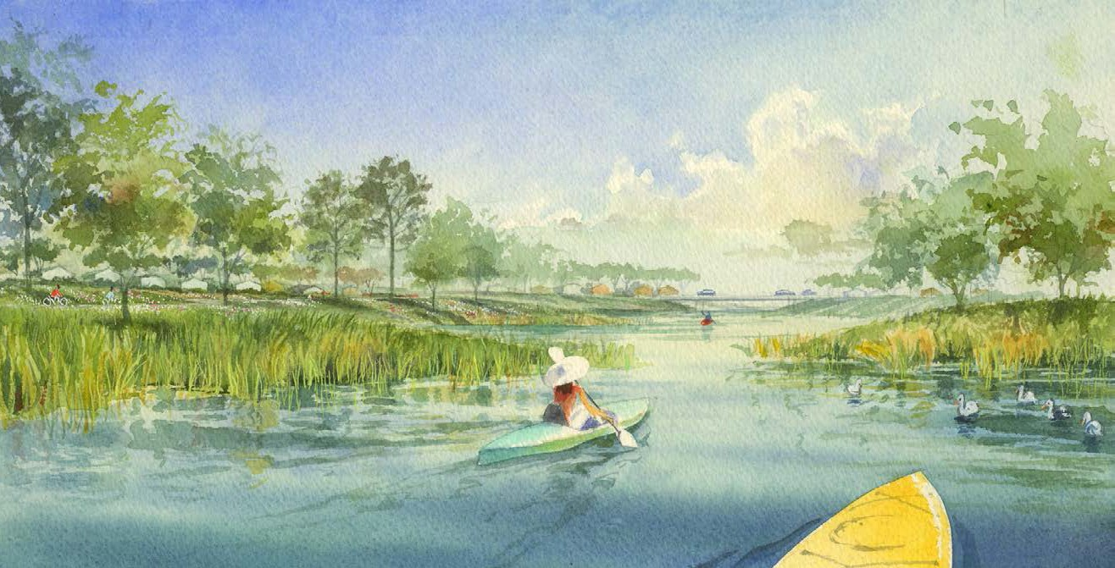
site rendering : basin view
MASTERPLAN
Storm water storage and water quality features combine with permanent pools and natural habitats to create enhanced recreational experiences.
37
golf course detention facilities and associated open space & park plan

