Slide 1
CLCWA Detention Facilities And Associated Open Space & Park Plan

Slide 2
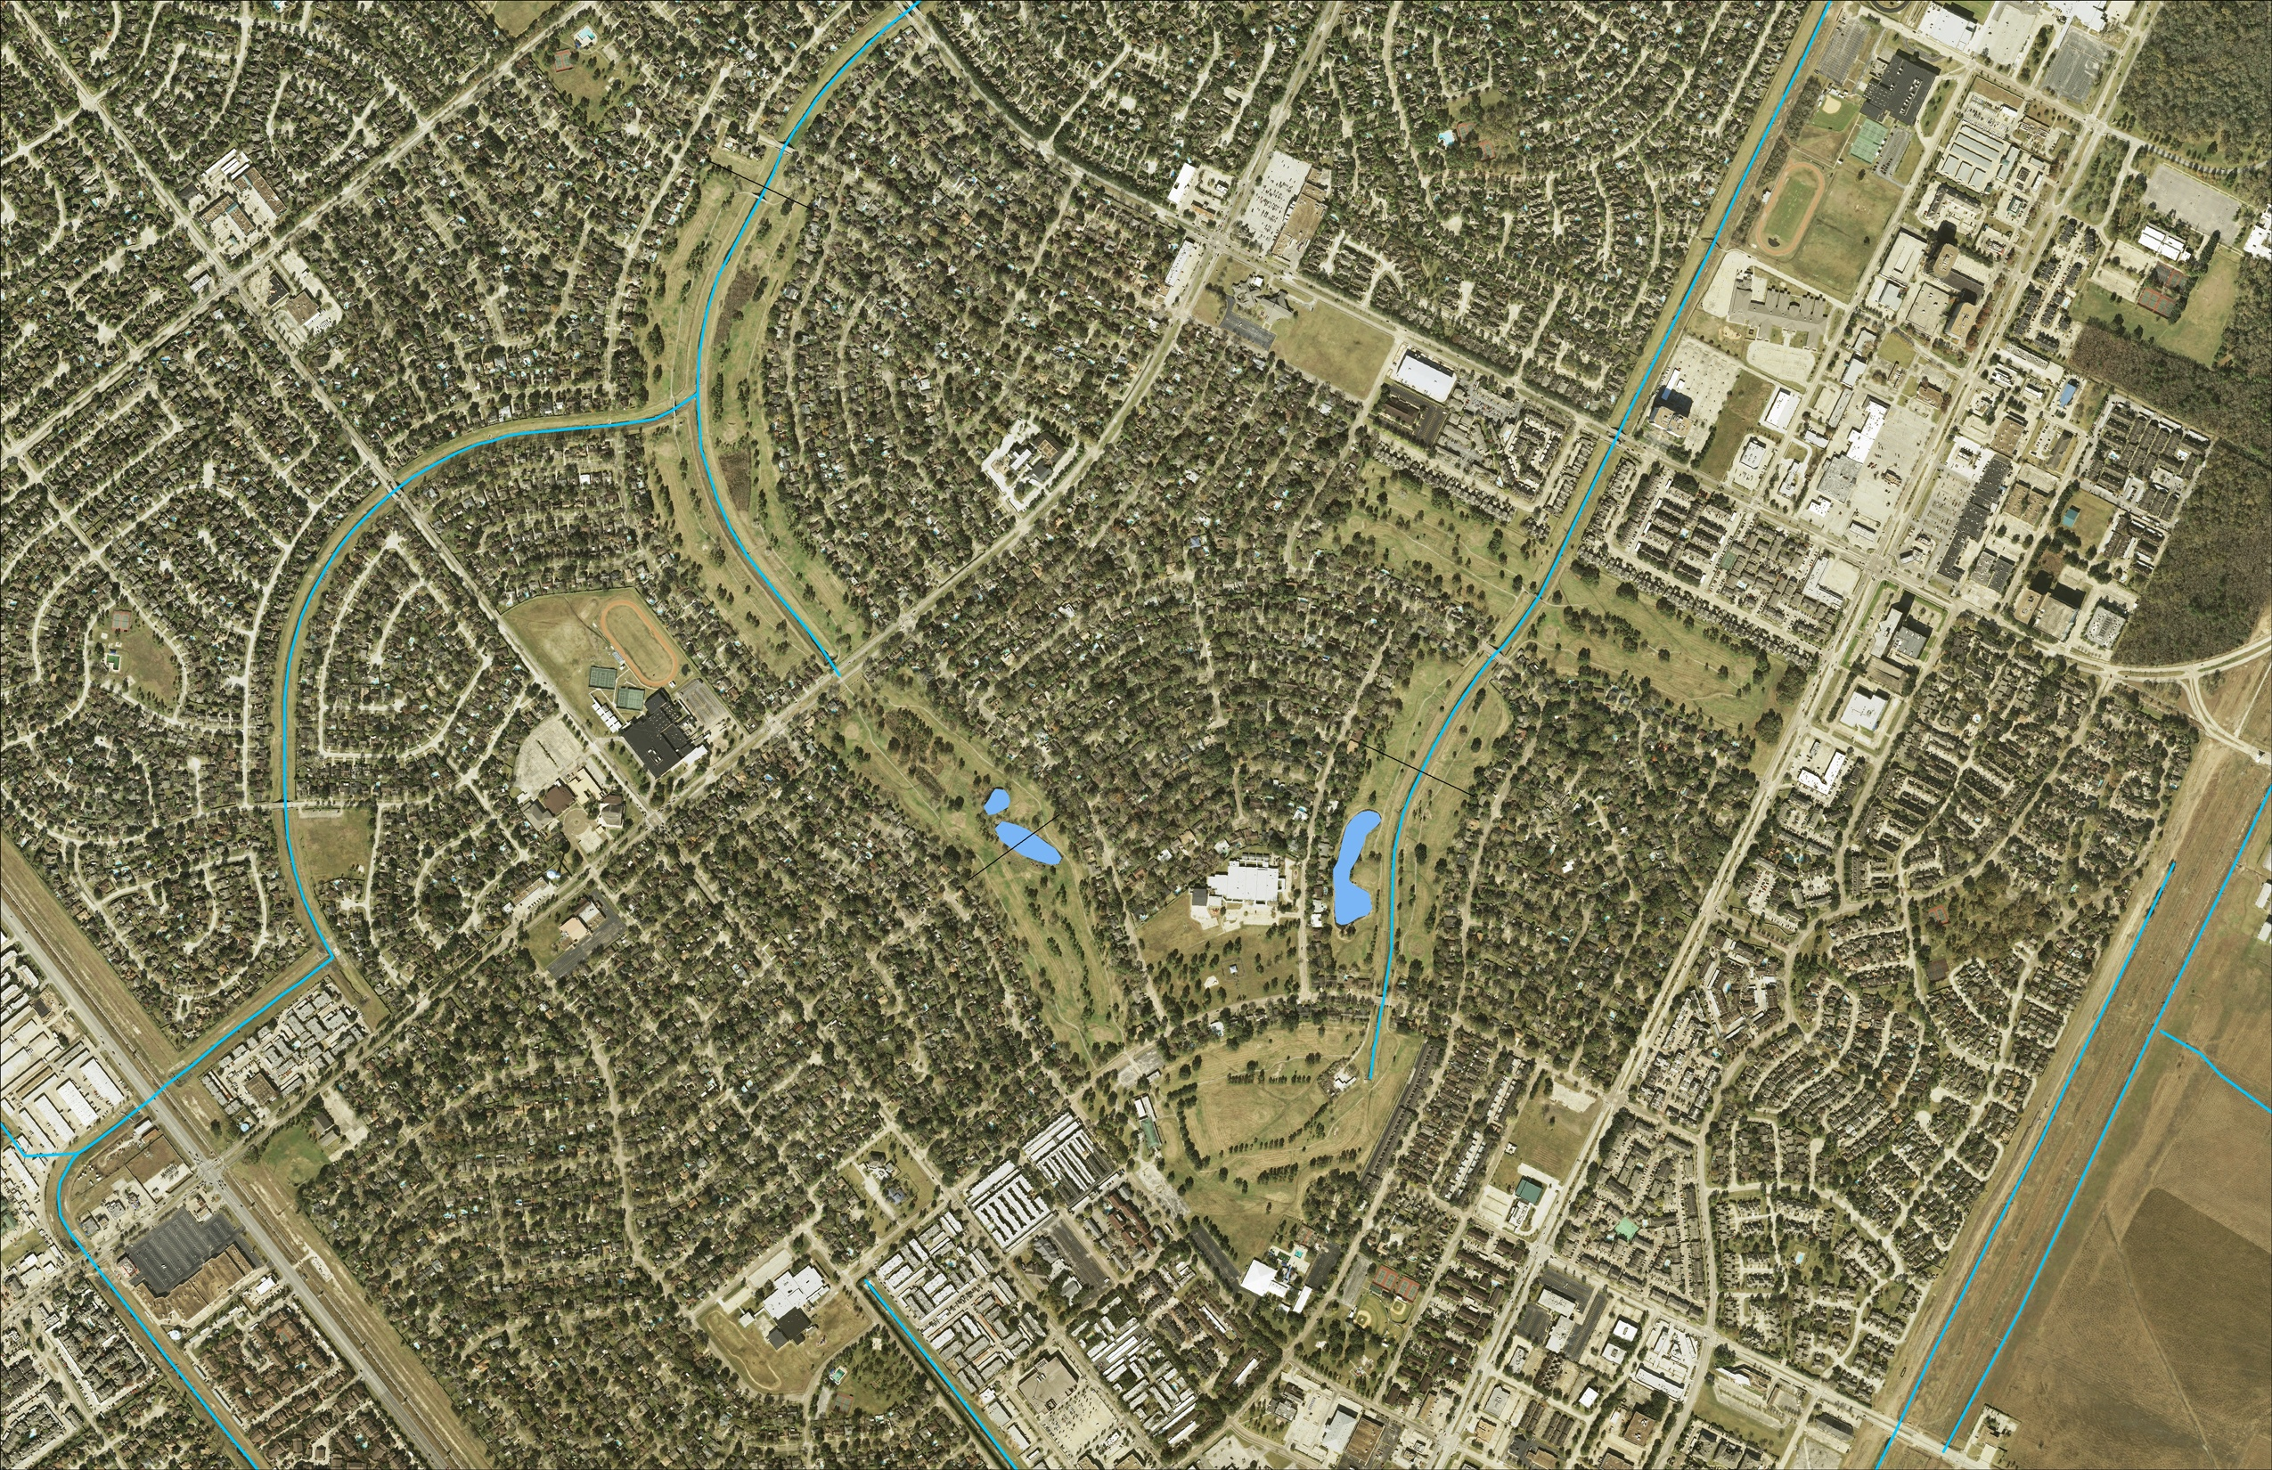

Slide 3
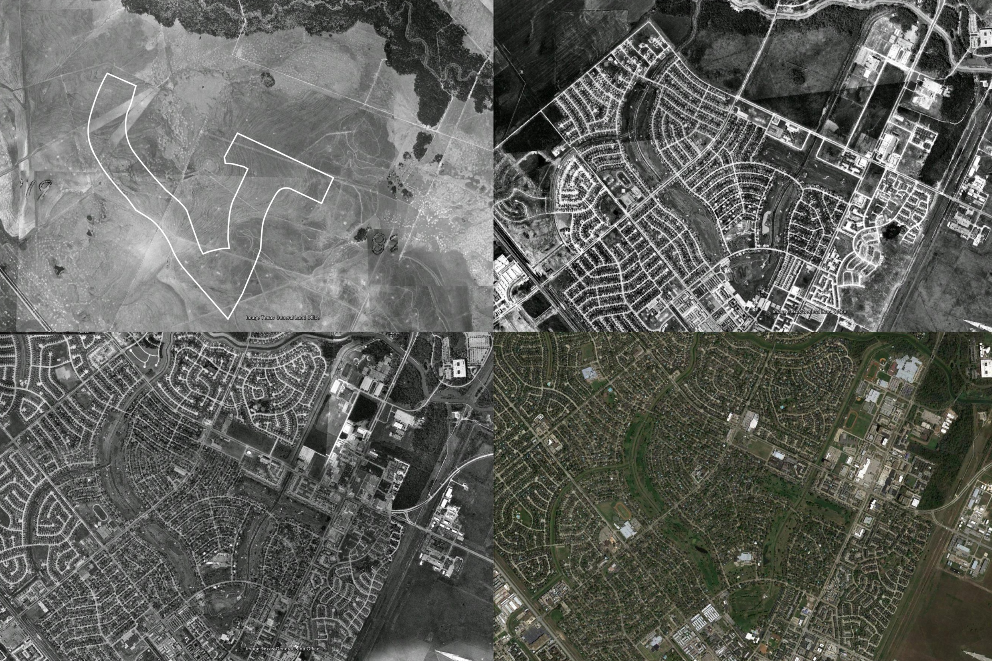
Aerial1944
Aerial 1978
Aerial1990
Aerial 2011

Slide 4
BACKGROUND I
Upper Gulf Coast
Past - Native Prairie / Prairie Pot Holes
Present - Created Landscapes
Homes & Business
Front Lawns, Ornamental Gardens & Golf Courses
Old Development Standards
Drainage = “Flood Control”
-“4 x 4” – four foot wide
and four foot deep!
(“…like draining a pool
table to the corner
pocket without tilting
the table!”)
“What’s Water Quality?!”

Slide 5
BACKGROUND II
New Development Standards
Drainage = “Flood Damage Reduction”
Amenitized storm water features
Water Quality Improvements
New Development Paradigm
Multi-purpose Facilities (FDR, Water Quality,
Open Space, Habitat)

Slide 6
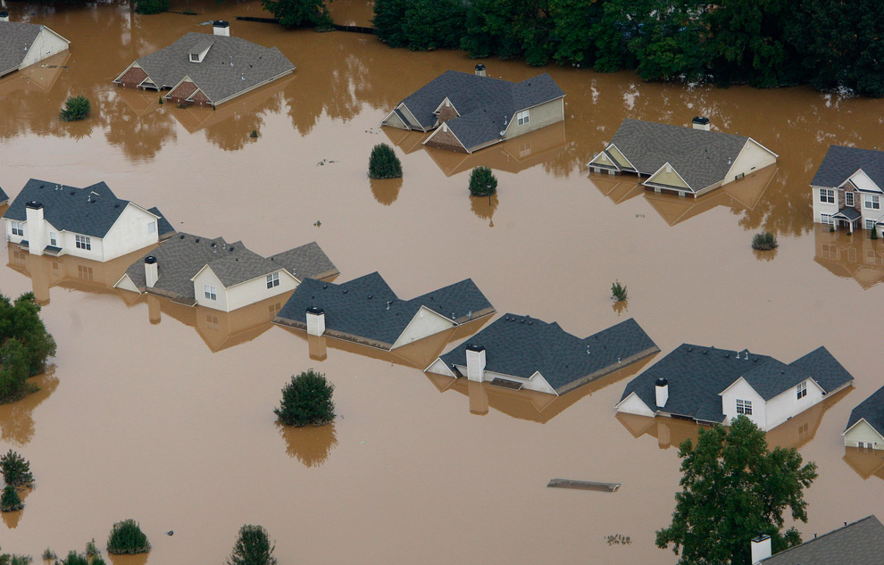

Slide 7
?

Slide 8
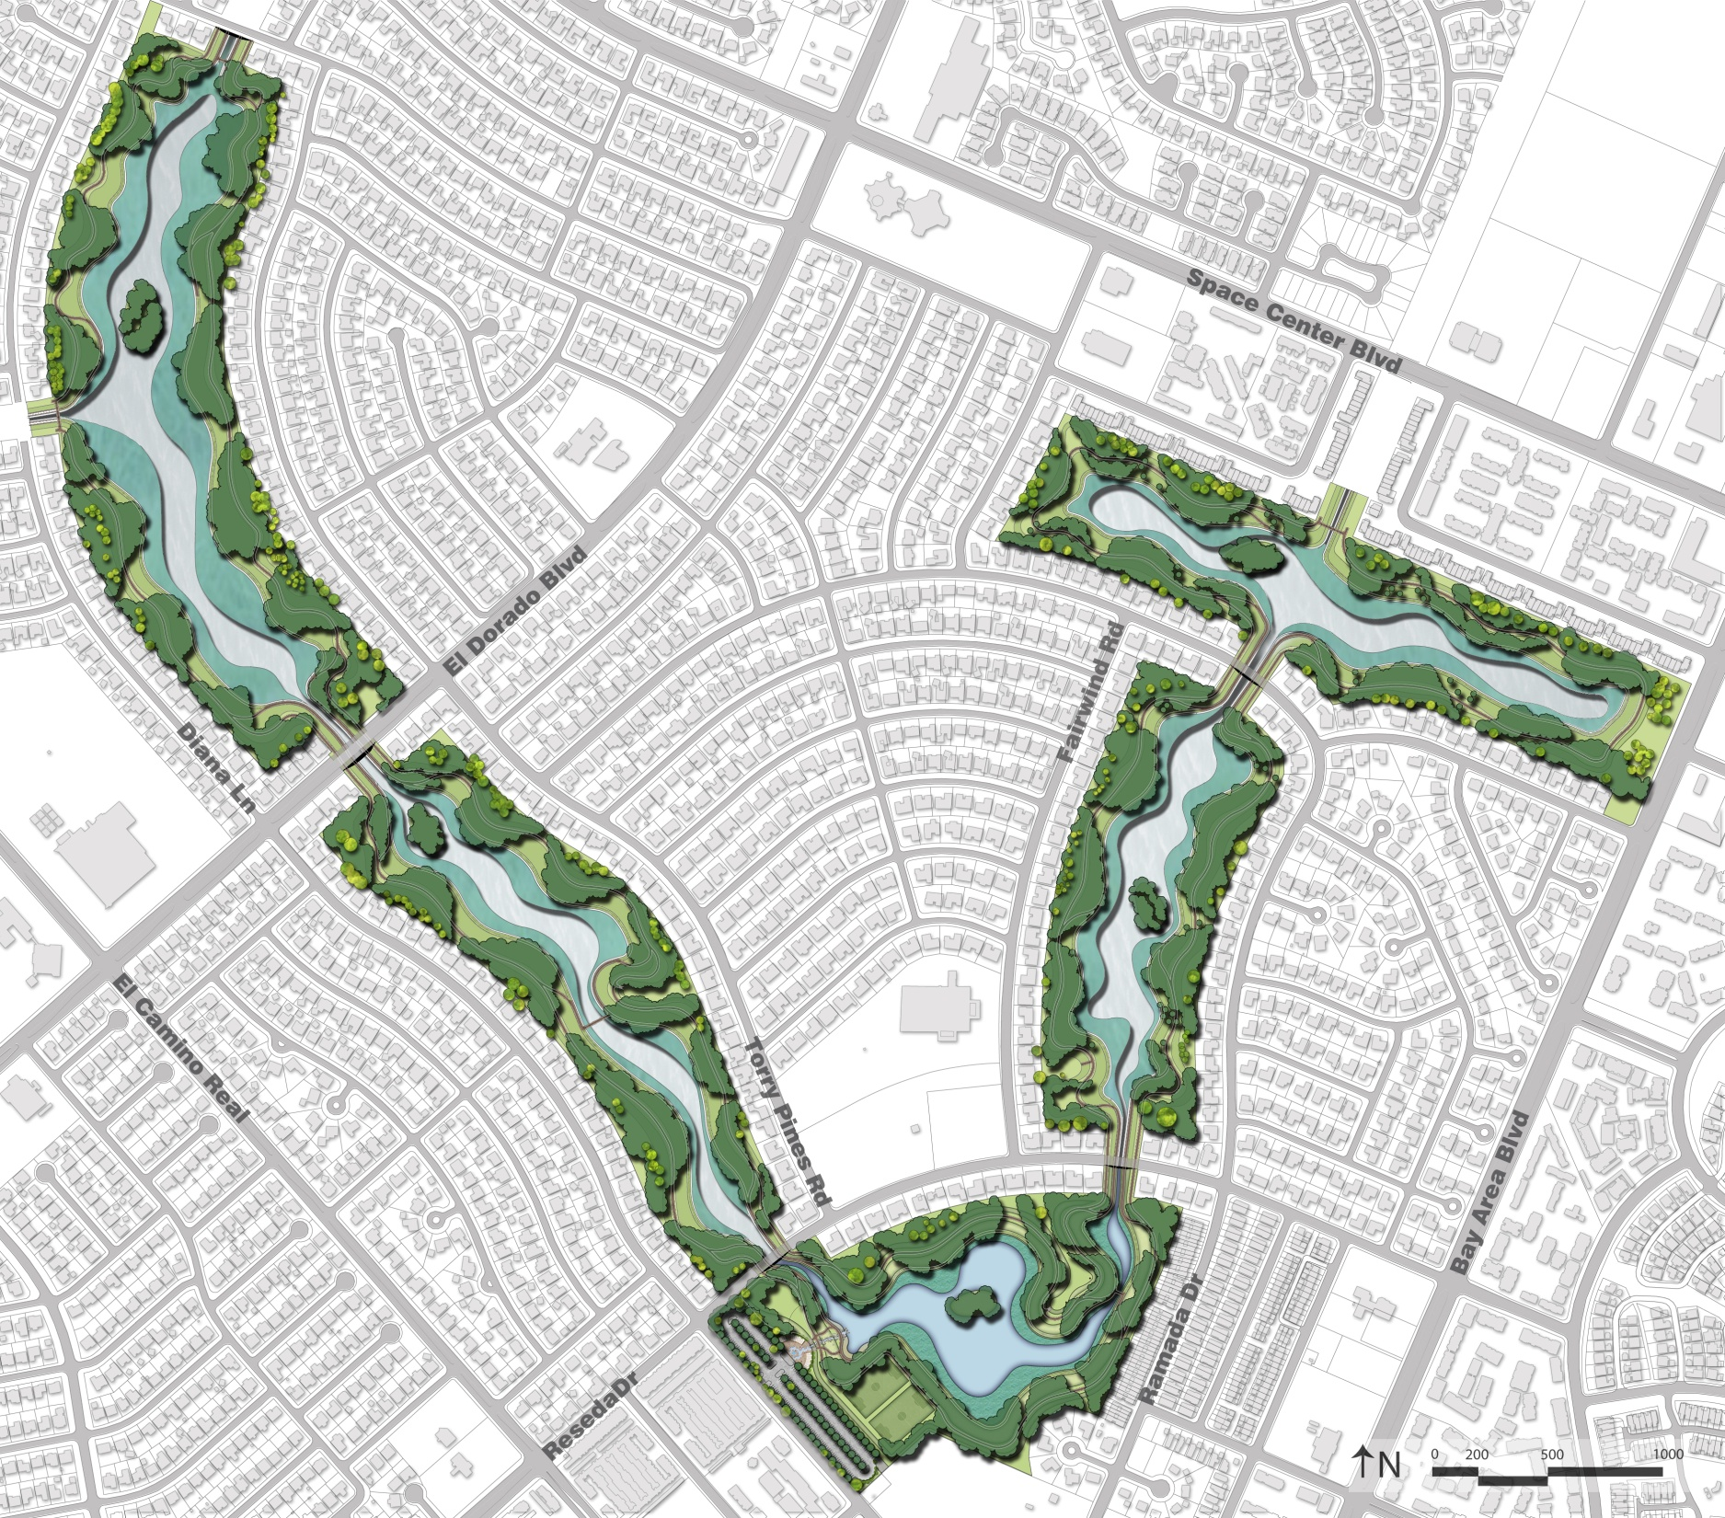

Slide 9
CLCWA Detention Facilities
Master Plan Metrics
178 acres
1,680-acre feet of storm water storage
FDR Excavation - 3.0 million cubic yards
Water storage depth - 13‘
Permanent water depth - 6‘
Permanent surface water area – 38 acres
Water Quality Wetland area – 39 acres
Upland / island areas – 101 acres

Slide 10
CLCWA Golf Course Detention
Master Plan Features
Water Quality Features
• Emergent wetland fringe
• Trash Interceptor baskets
• Tree canopy
• Return water flow polishing
Water Quality and Habitat Features
• Land forming with variable slopes to create a natural character
• Wet bottom basin
• Reforestation
• Islands (habitat areas)
• Nature-friendly habitat areas
Recreation Features
• Athletic Sports Fields – 2 x 150’ x 250’
• Entrance plaza / water feature
• Parking – 352 car spaces
• Picnic and open game areas
• Hike and bike trails – 6 miles

Slide 12
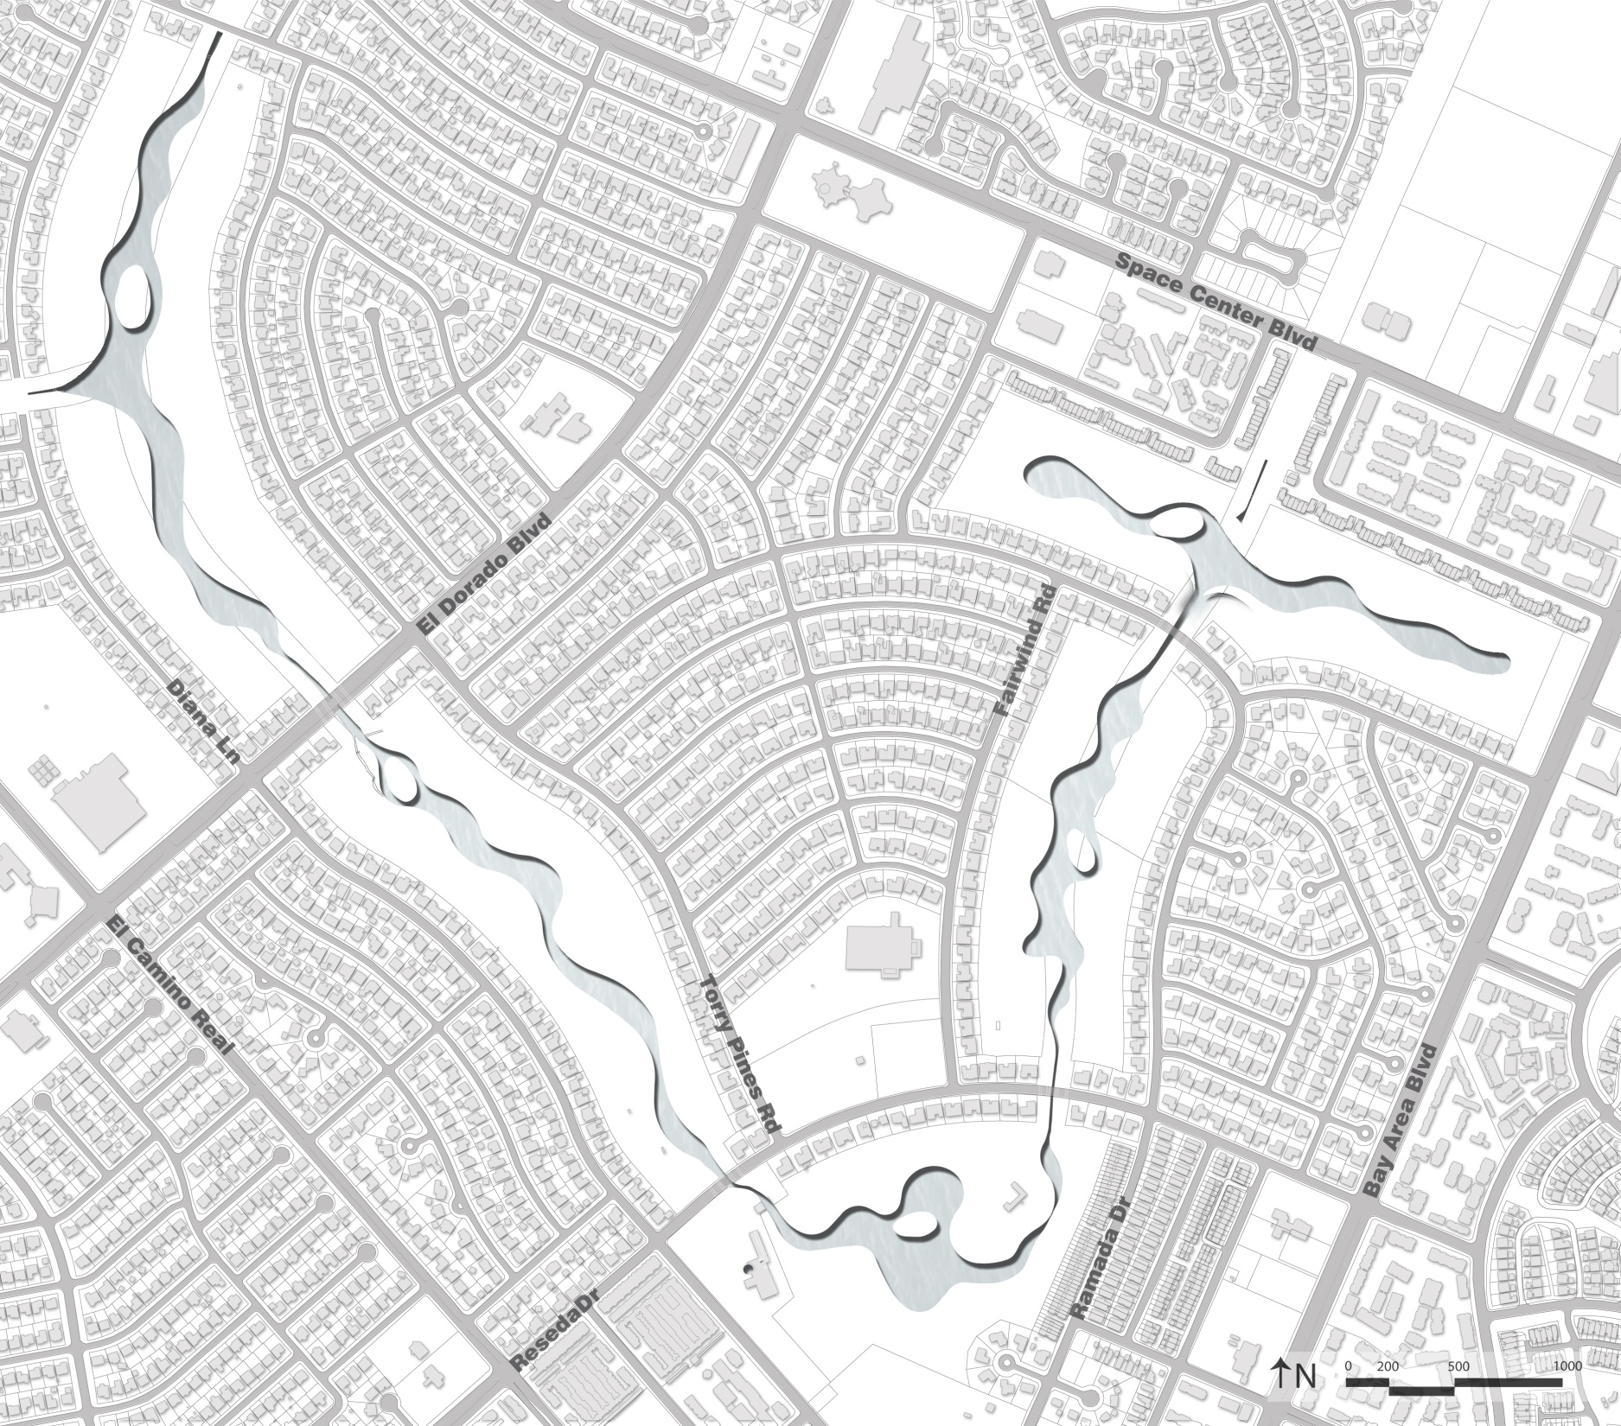
Permanent water area – 38 acres
Wetlands area – 39 acres
Upland / island areas – 101 acres
Paved trail – 6 miles
Preserved trees – 42% in perimeter zone
Reforested area

Slide 13
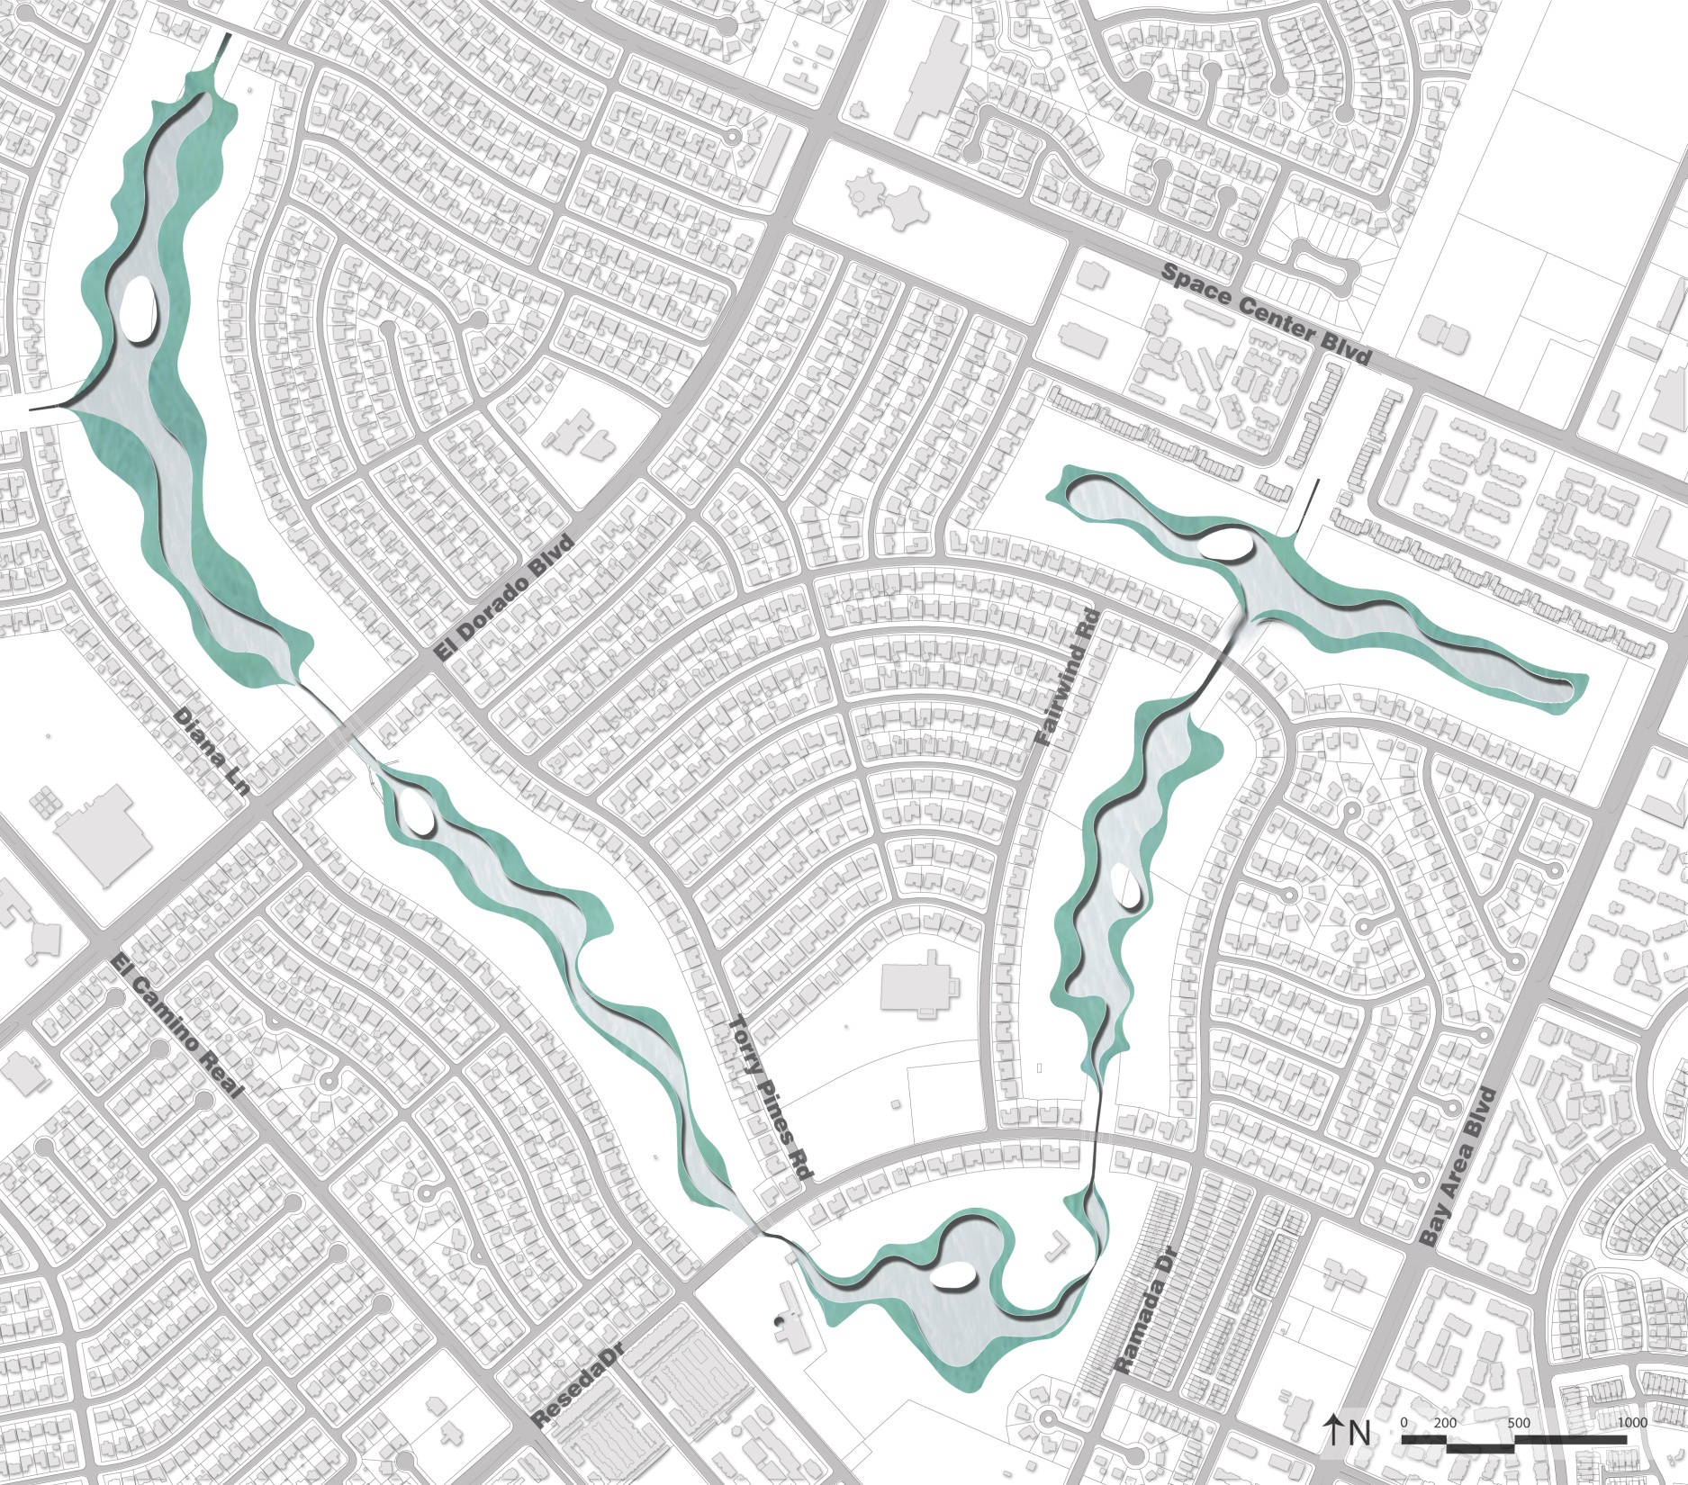
Permanent water area – 38 acres
Wetlands area – 39 acres
Upland / island areas – 101 acres
Paved trail – 6 miles
Preserved trees – 42% in perimeter zone
Reforested area

Slide 14
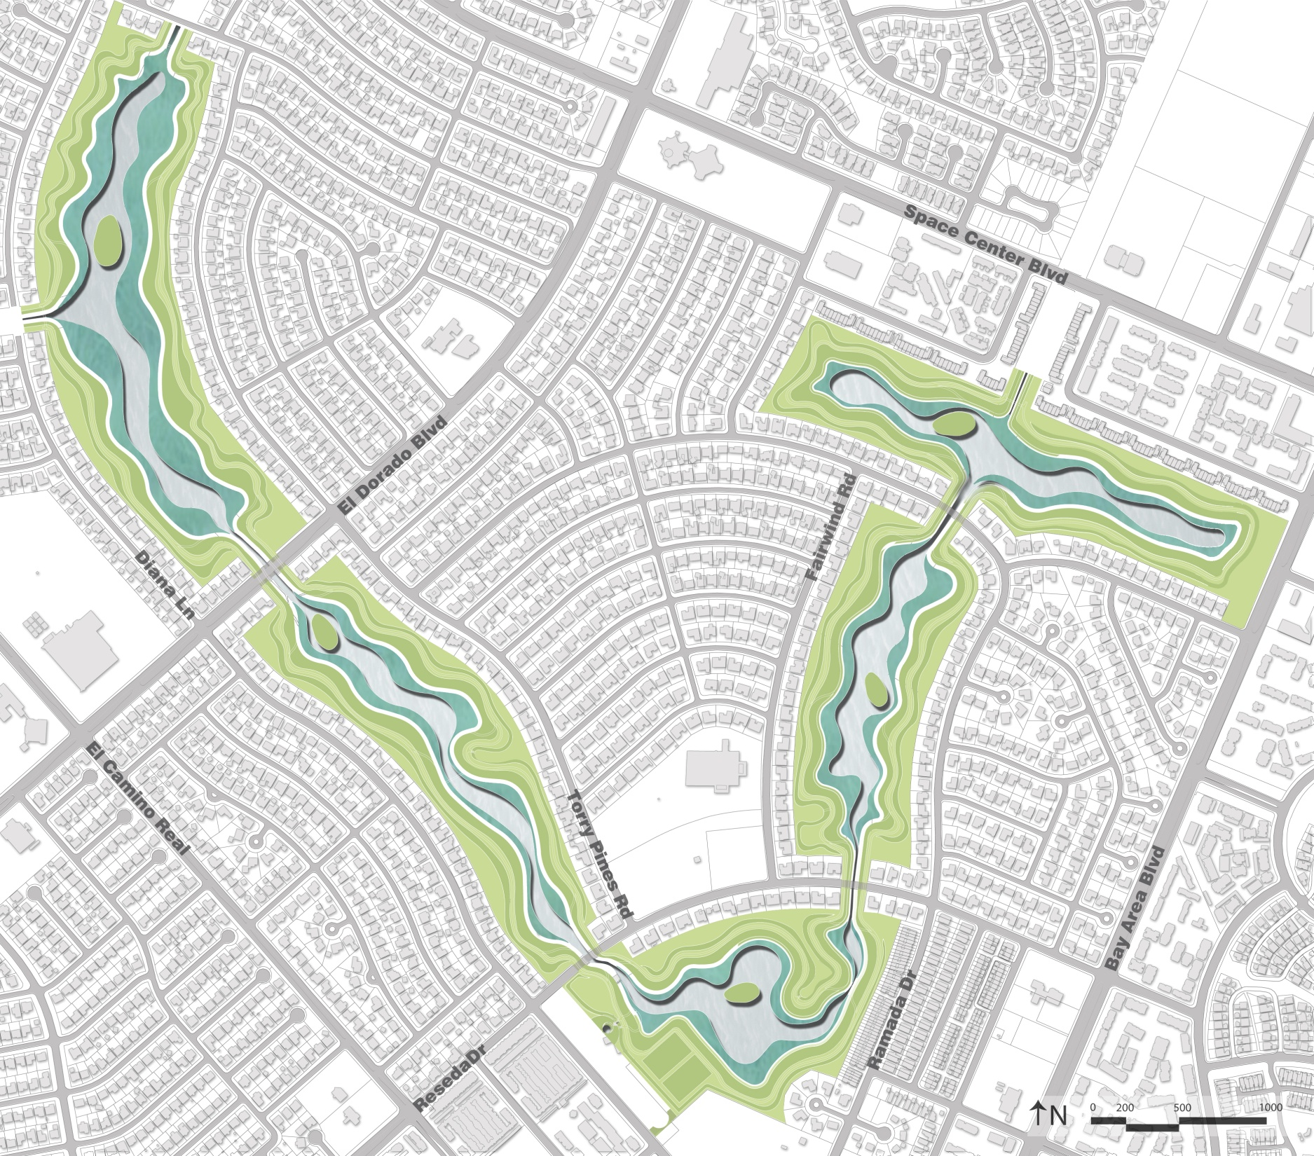
Permanent water area – 38 acres
Wetlands area – 39 acres
Upland / island areas – 101 acres
Paved trail – 6 miles
Preserved trees – 42% in perimeter zone
Reforested area

Slide 15
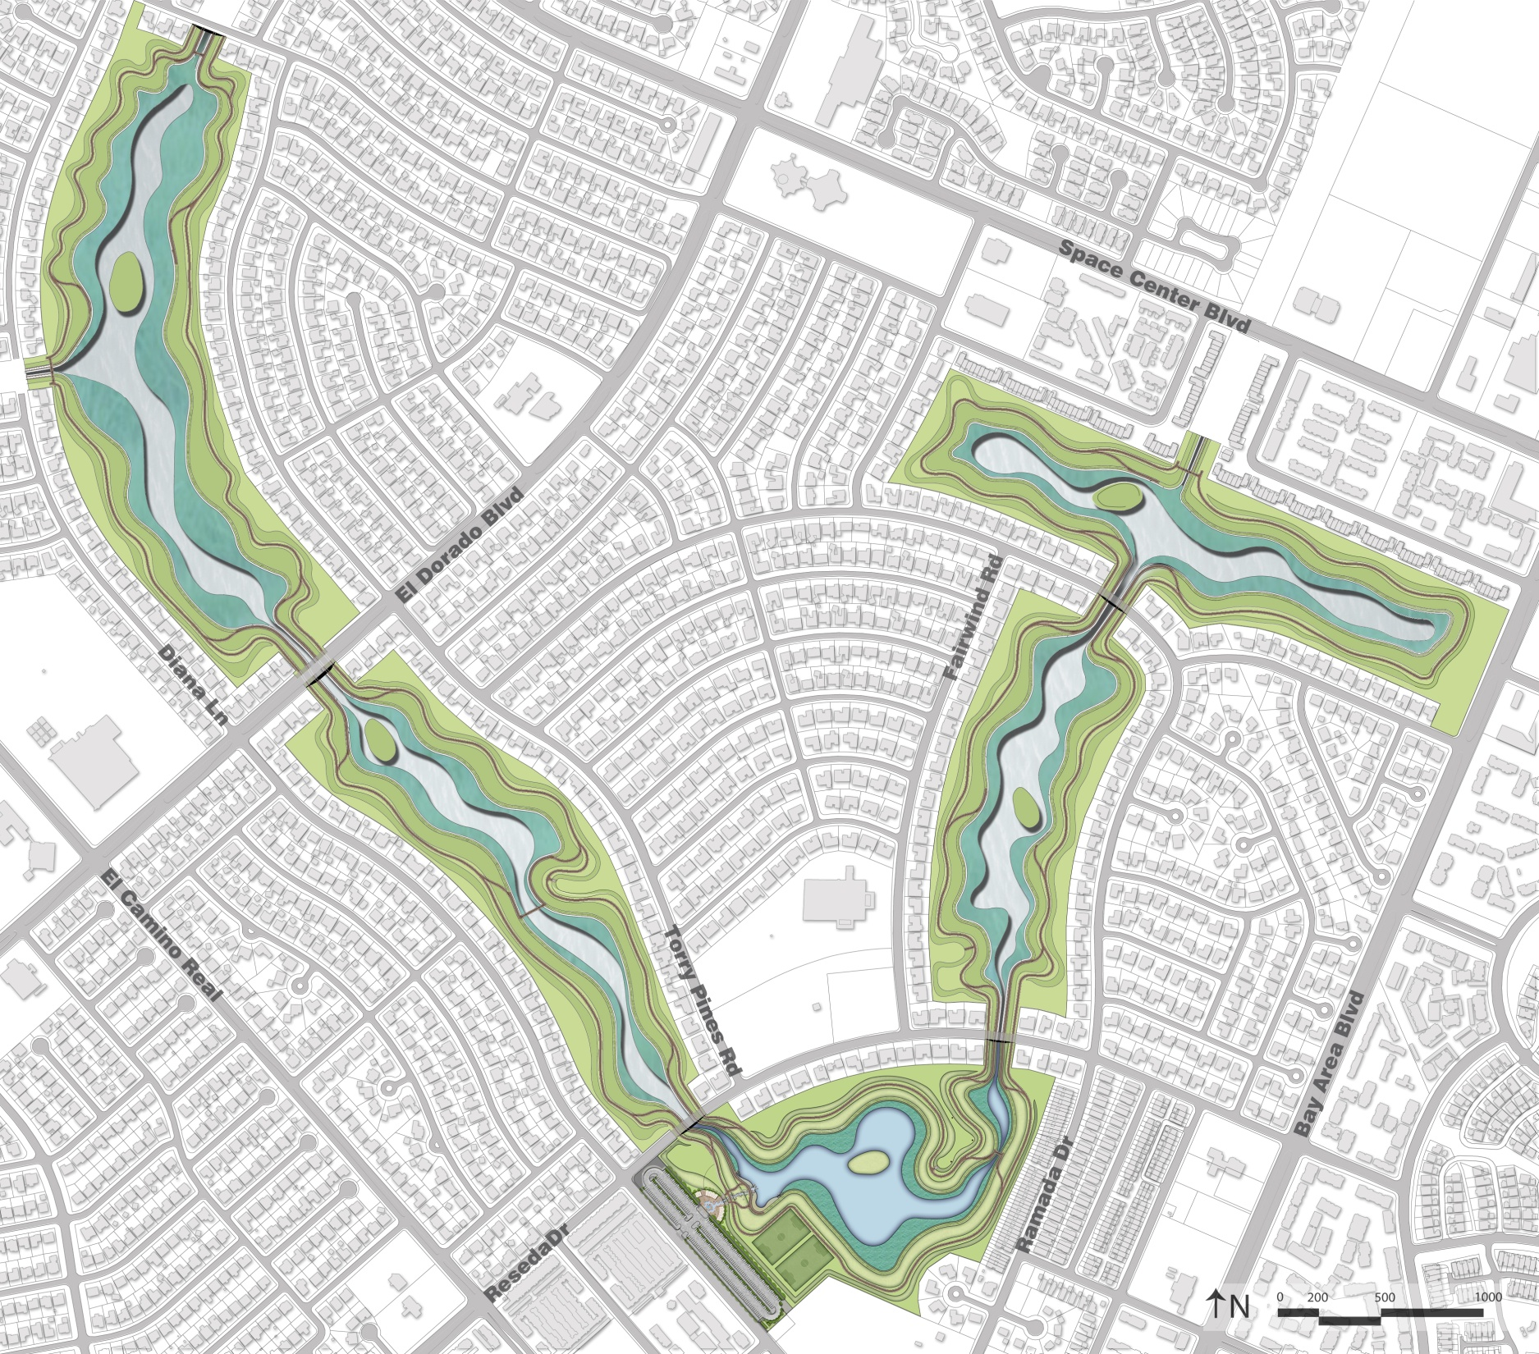
Permanent water area – 38 acres
Wetlands area – 39 acres
Upland / island areas – 101 acres
Paved Trail – 6 miles
Preserved trees - 42% of the existing trees
Reforested area

Slide 16
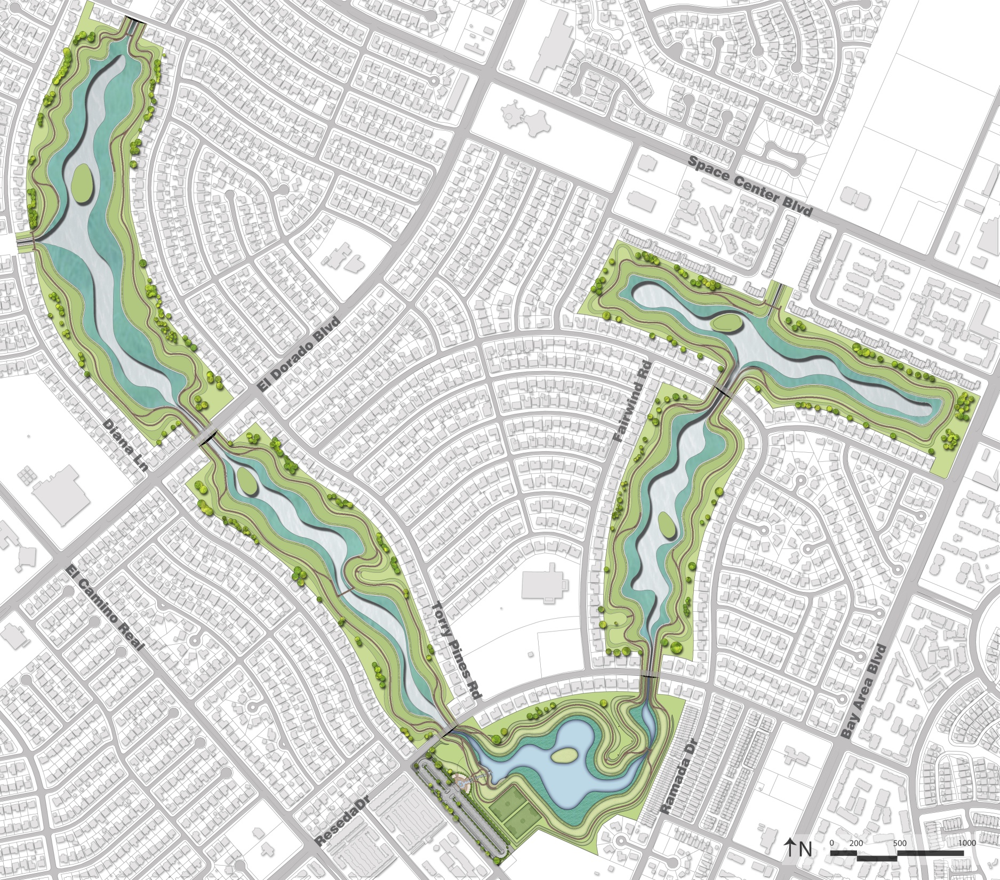
Permanent water area – 38 acres
Wetlands area – 39 acres
Upland / island areas – 101 acres
Paved Trail – 6 miles
Preserved trees – 42% in perimeter zone
Reforested area

Slide 17
Permanent water area – 38 acres
Wetlands area – 39 acres
Upland / island areas – 101 acres
Paved trail – 6 miles
Preserved trees - 42% in perimeter zone
Reforested area

Slide 18
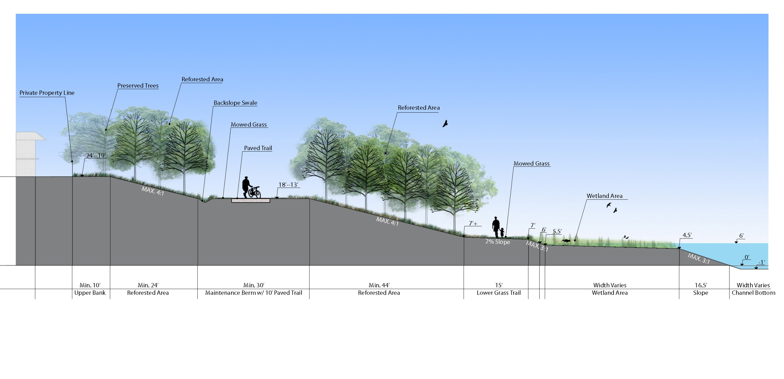
Typical Section

Slide 19
CLCWA Detention Facilities
(Possible Phasing)
Phase 1 1 - 5 years
Phase 2 4 - 7 years
Phase 3 7 - 9 years
Phase 4 9 - 12 years
Phase 5 12 - 15 years

Slide 20
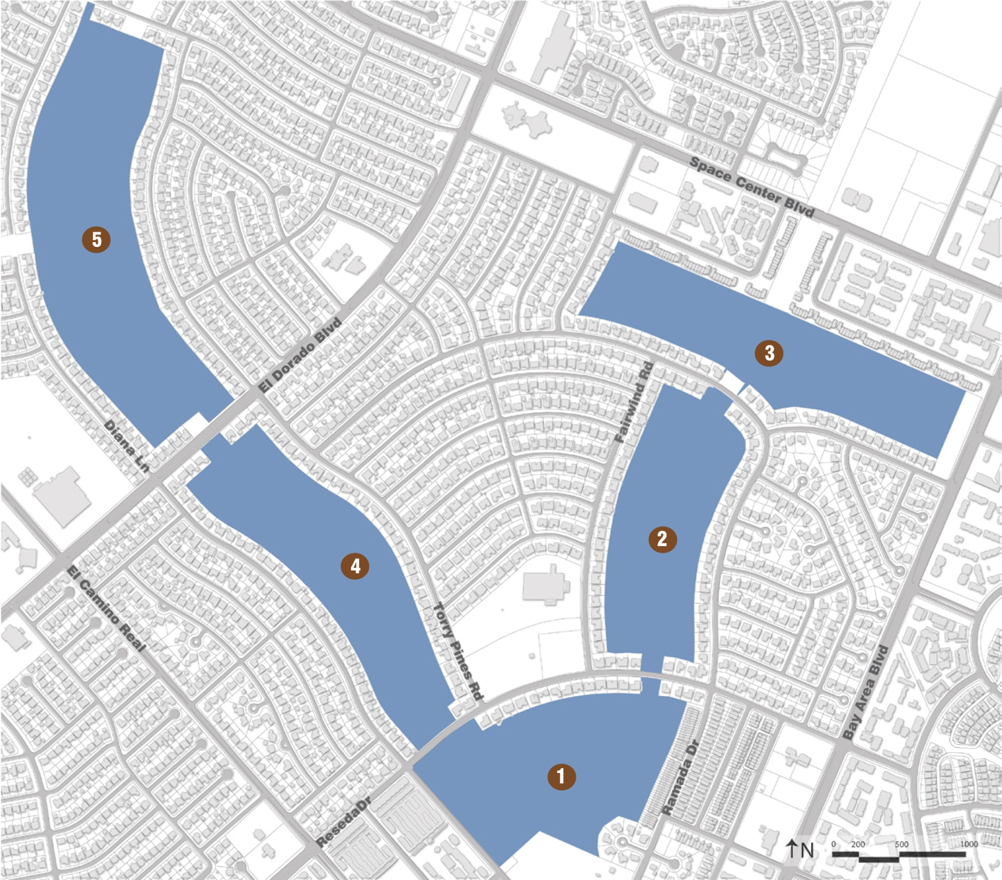

Slide 21
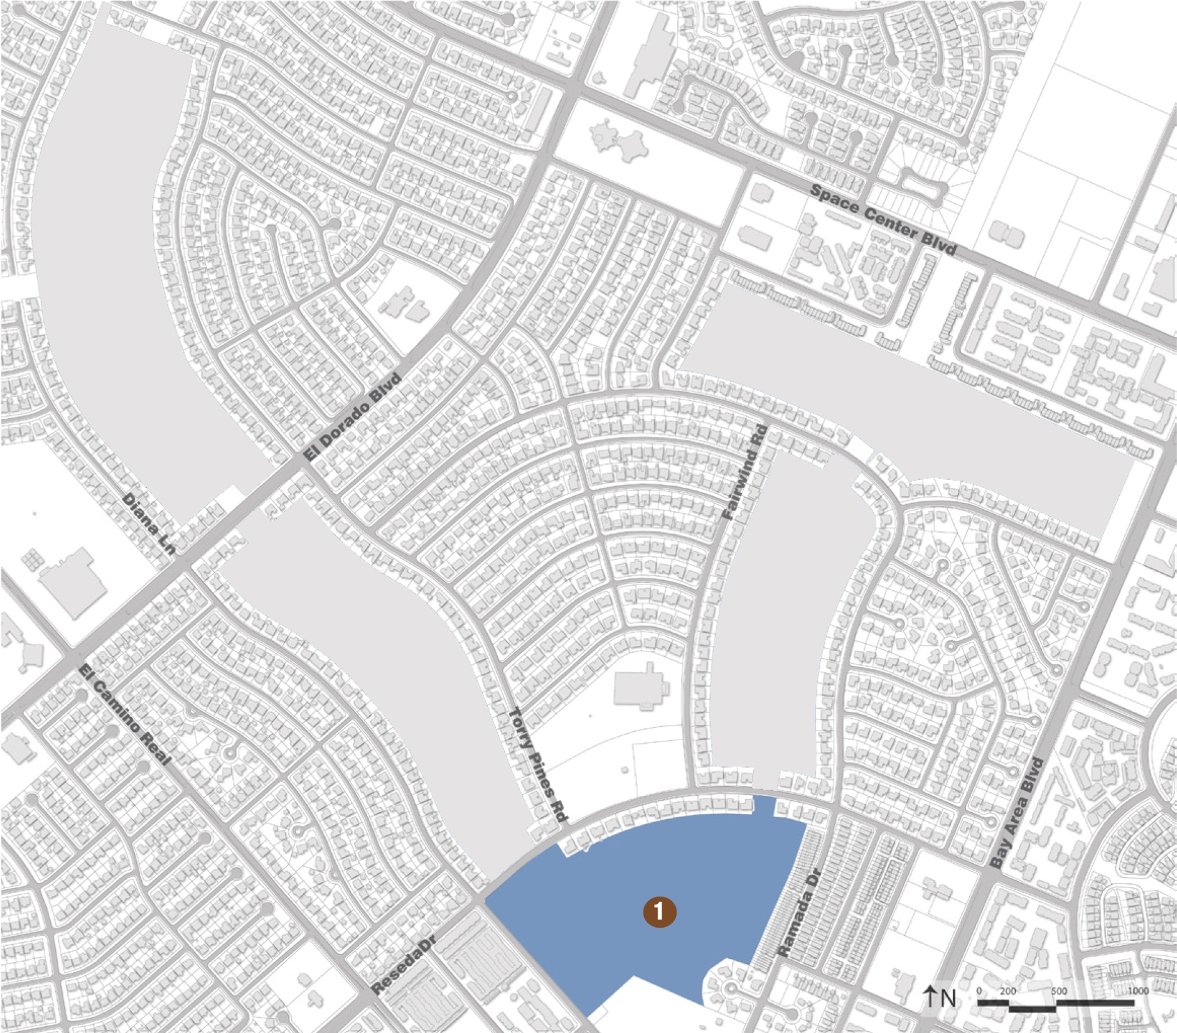
Phase I Base Plan
Water storage – 345 ac/ft
Permanent water area – 8 acres
Wetlands area – 6 acres
Island area – 0.5 acres
Paved Trail – 1.1 miles

Slide 22
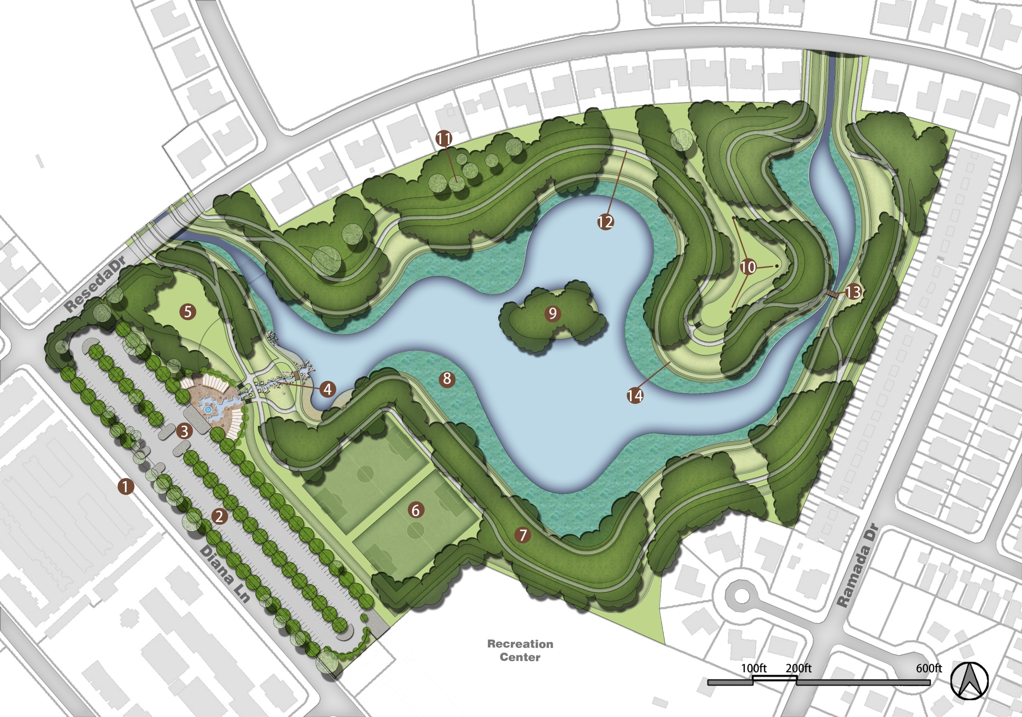

Slide 23
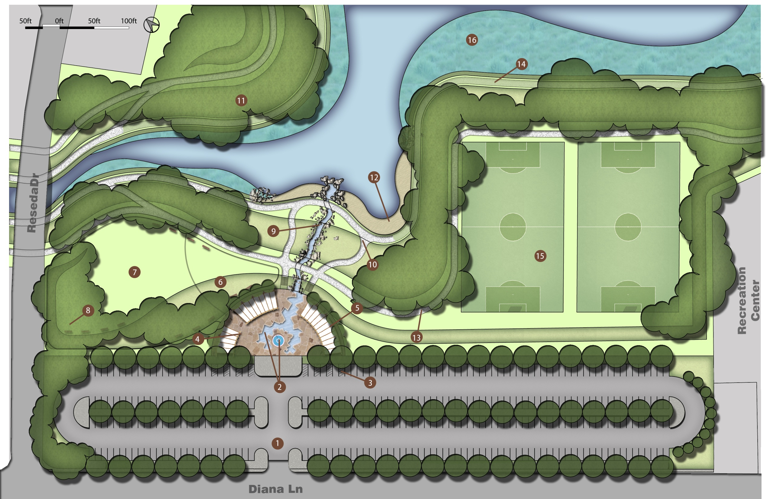

Slide 24
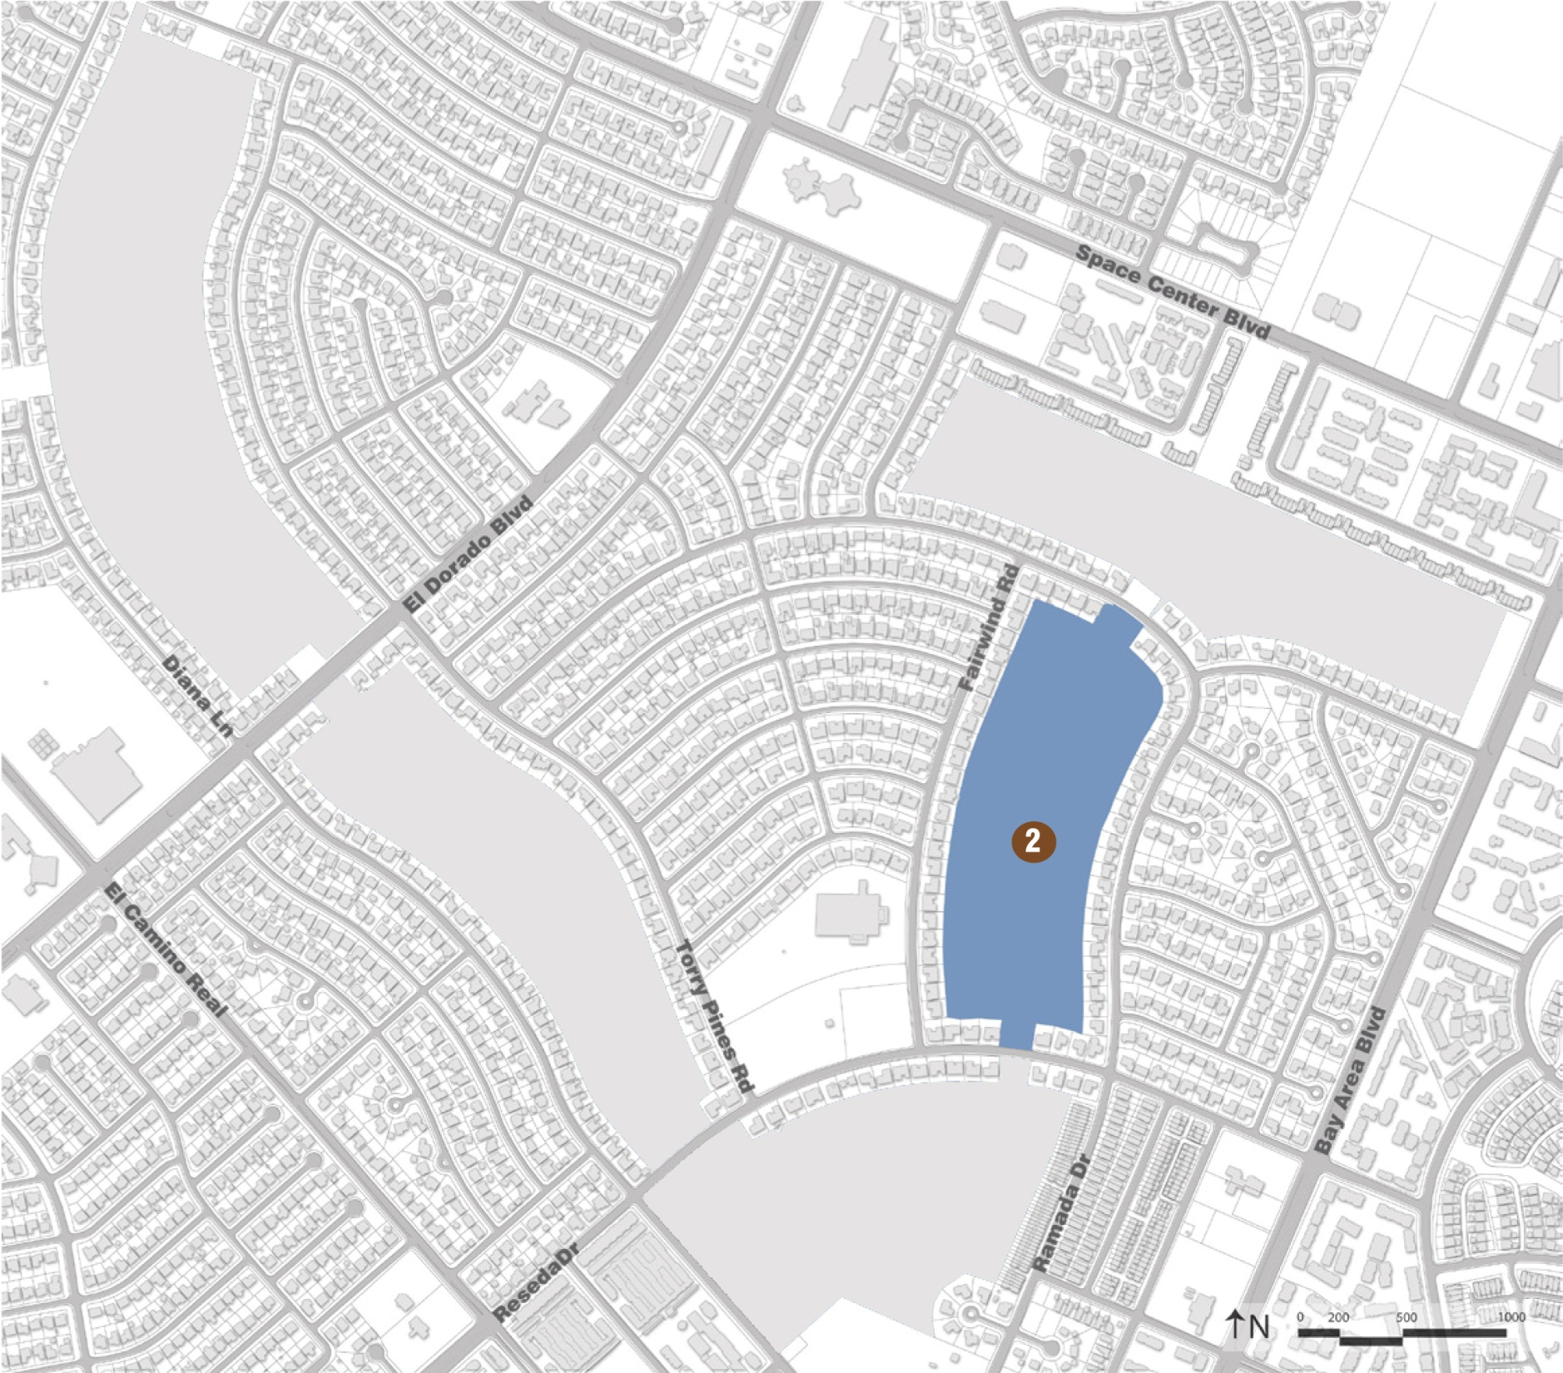
Phase II Base Plan
Water storage – 260 ac/ft
Permanent water area – 5 acres
Wetlands area – 9 acres
Island area – 0.5 acres
Paved Trail – 1 miles

Slide 25
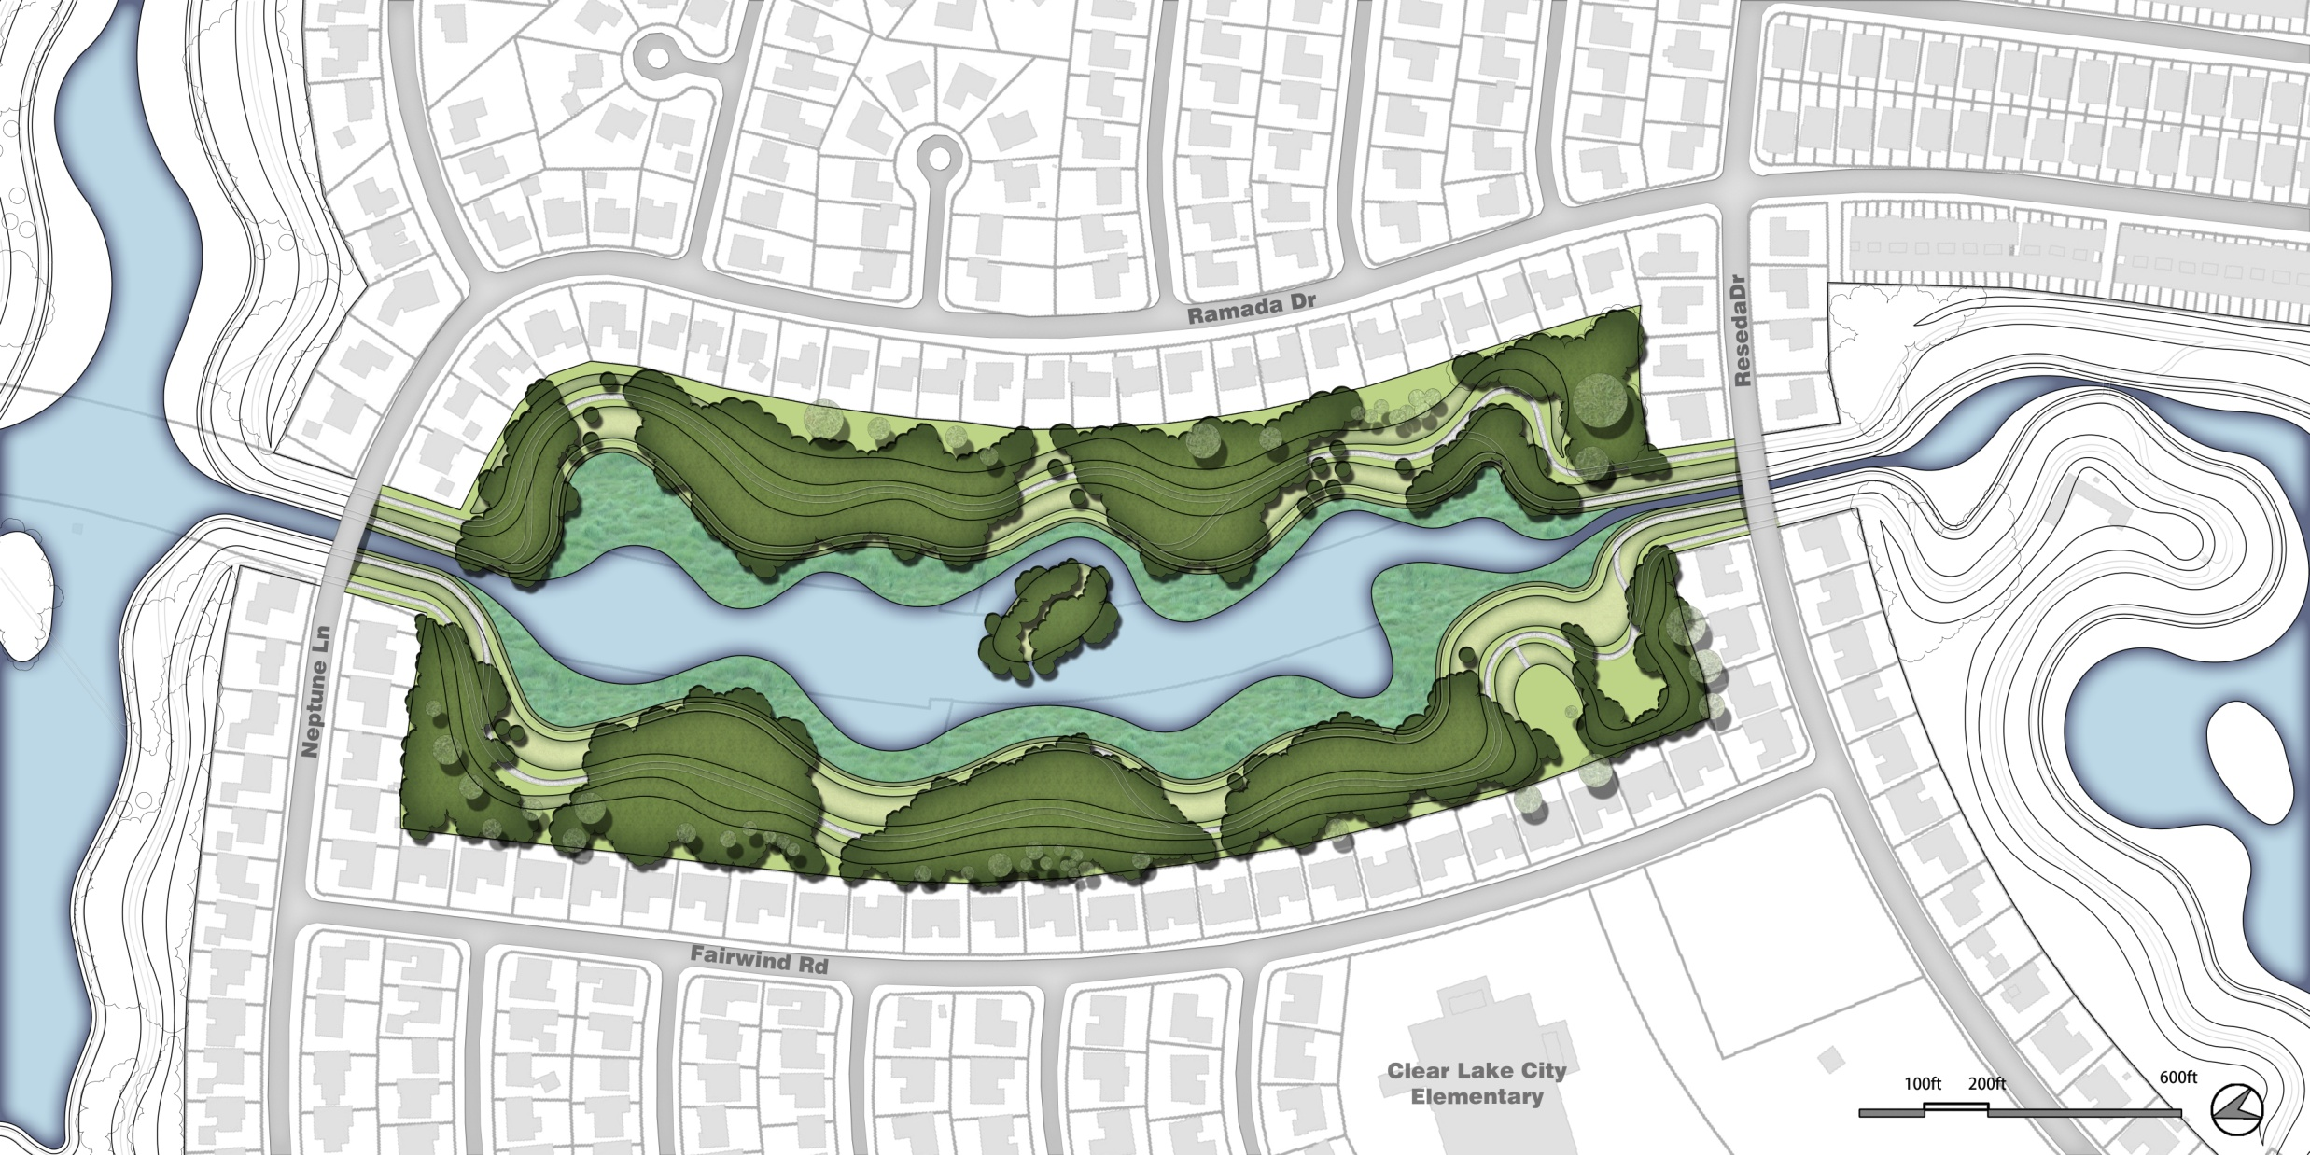

Slide 26
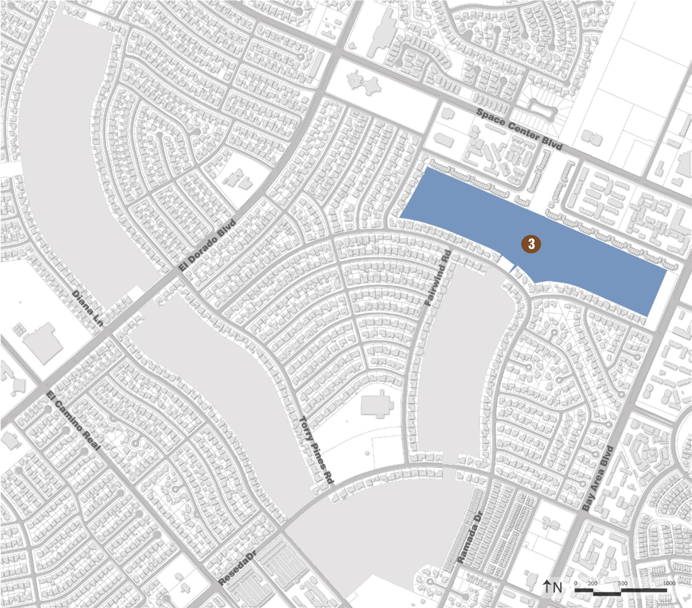
Phase III Base Plan
Water storage – 318 ac/ft
Permanent water area – 8 acres
Wetlands area – 6 acres
Island area – 0.5 acres
Paved Trail – 1.3 miles

Slide 27
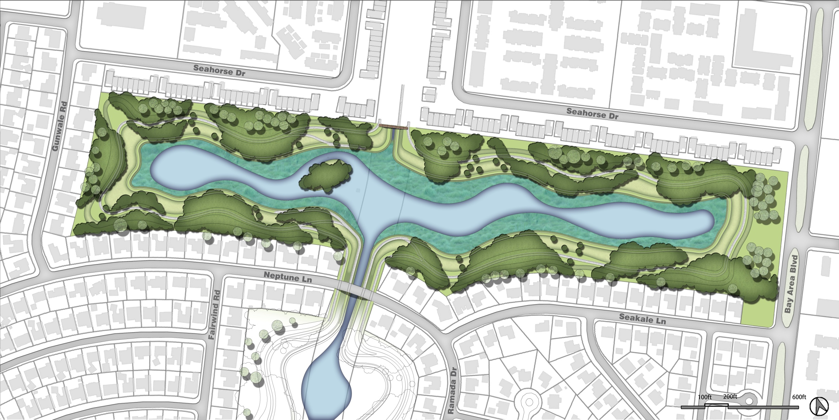

Slide 28
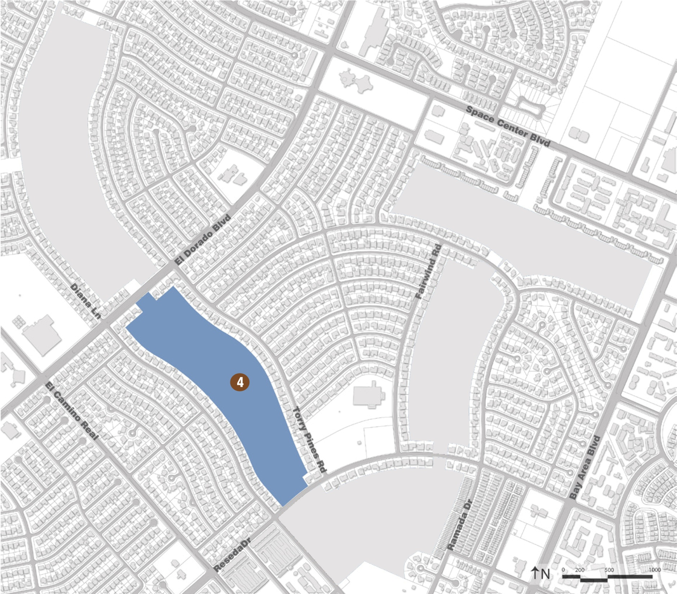
Phase IV Base Plan
Water storage – 292 ac/ft
Permanent water area – 7 acres
Wetlands area – 7 acres
Island area – 0.5 acres
Paved Trail – 1.2 miles

Slide 29
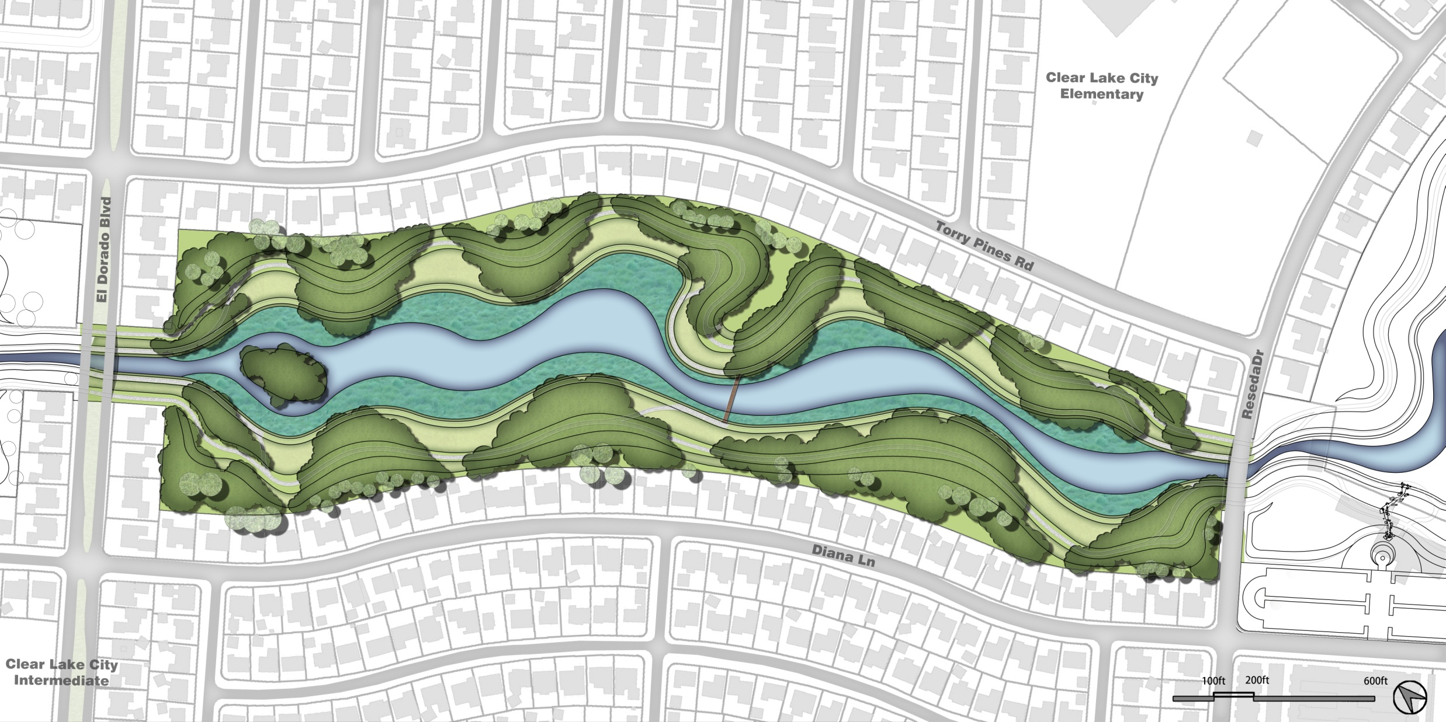

Slide 30
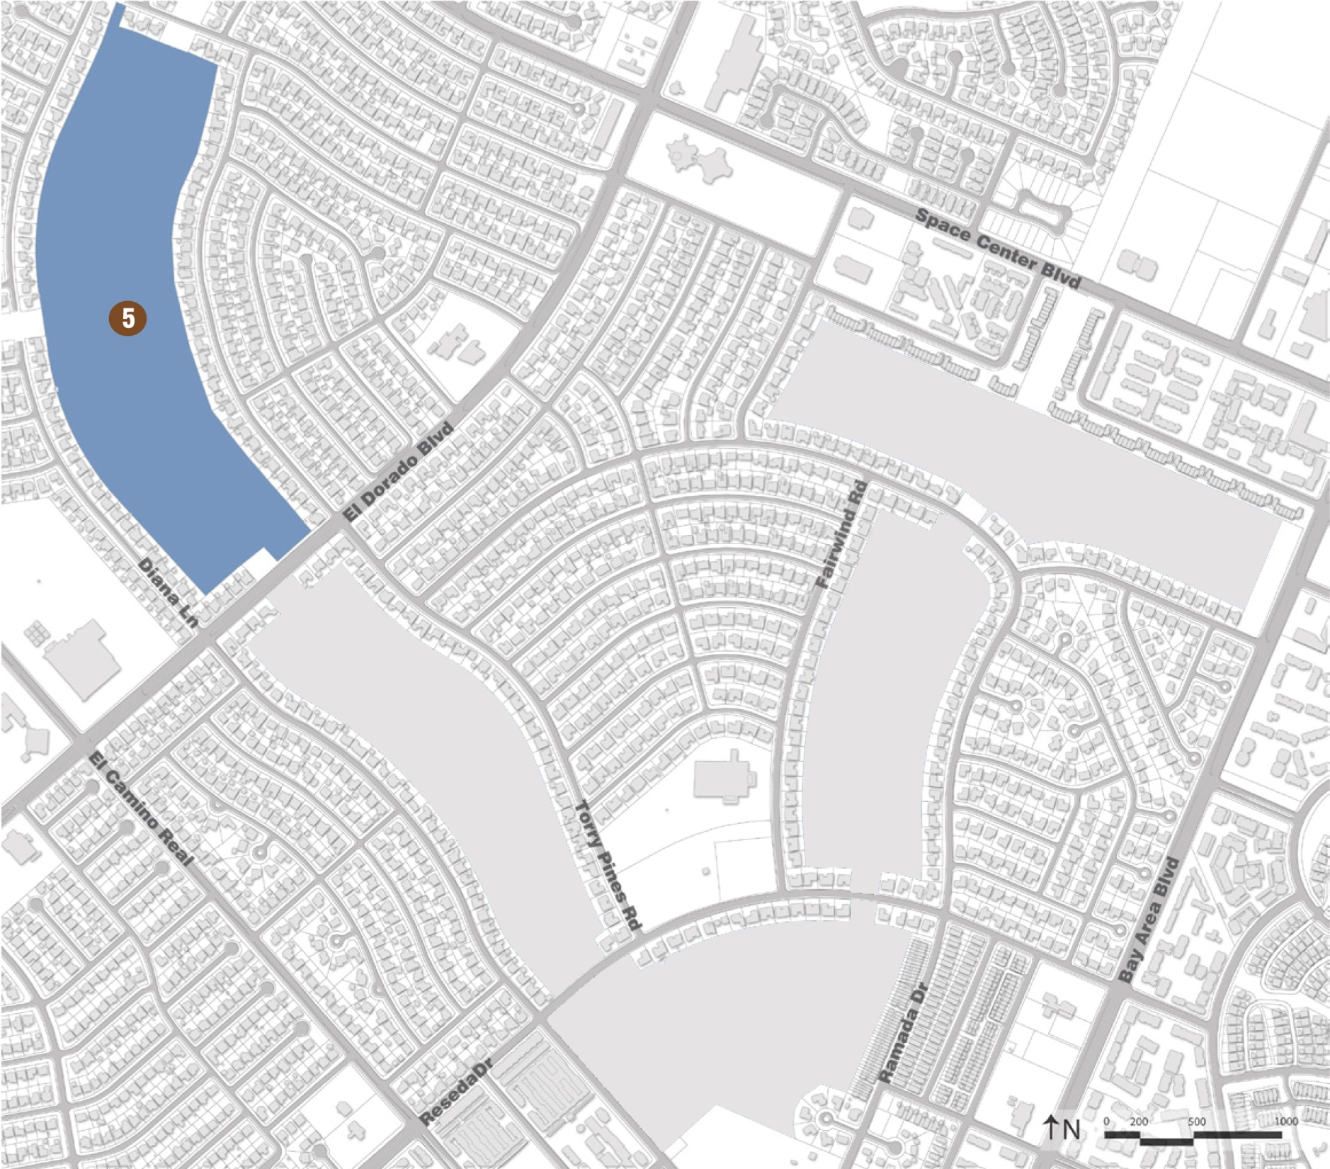
Phase IV Base Plan
Water storage – 442 ac/ft
Permanent water area – 10 acres
Wetlands area – 11 acres
Island area – 0.5 acres
Paved Trail – 1.5 miles

Slide 31
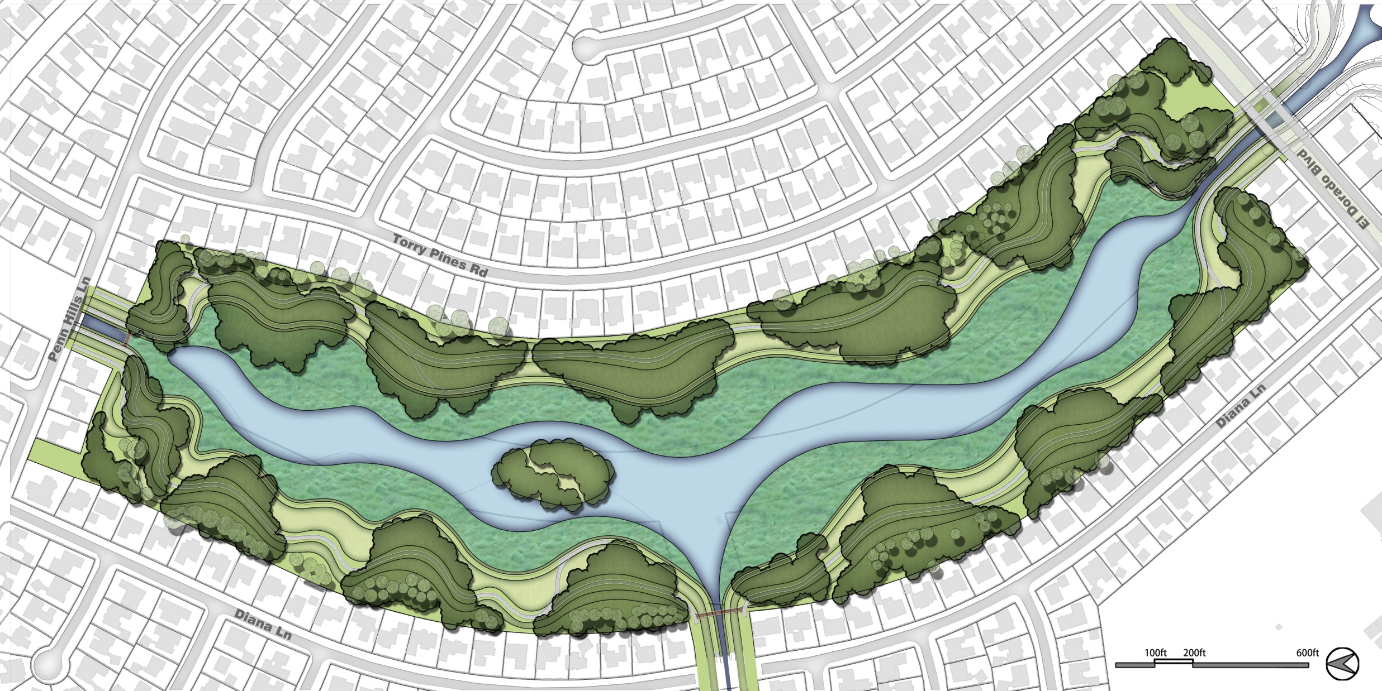

Slide 32
CLCWA Detention Facilities
“Making It Multi-Purpose”
Flood Damage Reduction
Water Quality Improvements
Habitat Creation
Recreation

Slide 33
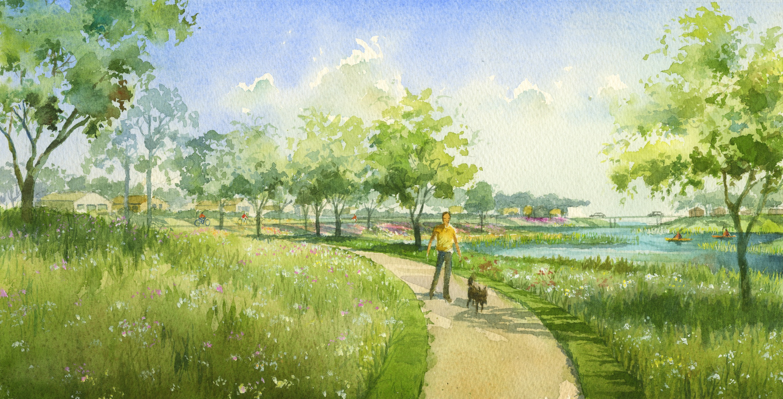

Slide 34
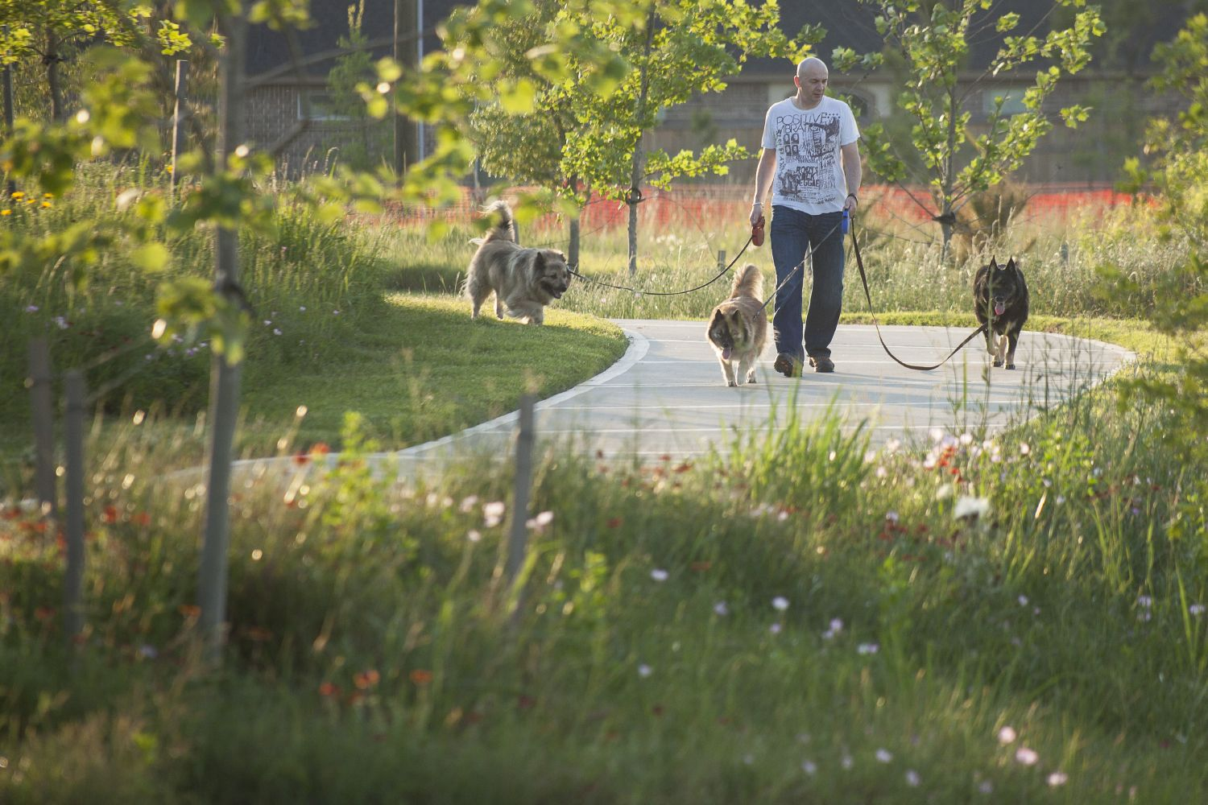

Slide 35
Thank You

